Slide 1
Teaching at a Non-Academic
Senior High School

Slide 2
Potential Problems
Students are misbehaved and don’t really care about learning English
  Your students have the English level of elementary students and the apathy level of teenagers
You feel like you are unable to challenge yourself or your students
You find that the low English level of students makes it difficult for you to establish relationships with them

Slide 3
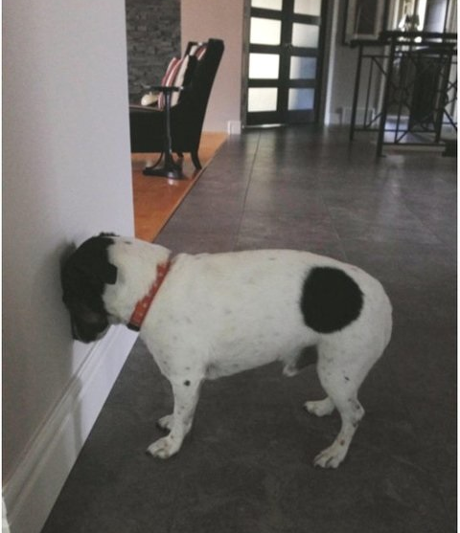
Potential Problems
Your school does not focus its resources on the English department or other general subjects
Your friends who work at academic high schools or elementary schools are constantly posting things on facebook about how great their students are

Slide 4
Potential Benefits
You may be given more opportunity for you to run your own lessons
Your school is likely to compensate for lack of high academic ability with other skills and resources!
Even if the students are apathetic, there are probably some really great teachers and staff members who work at your school!

Slide 5
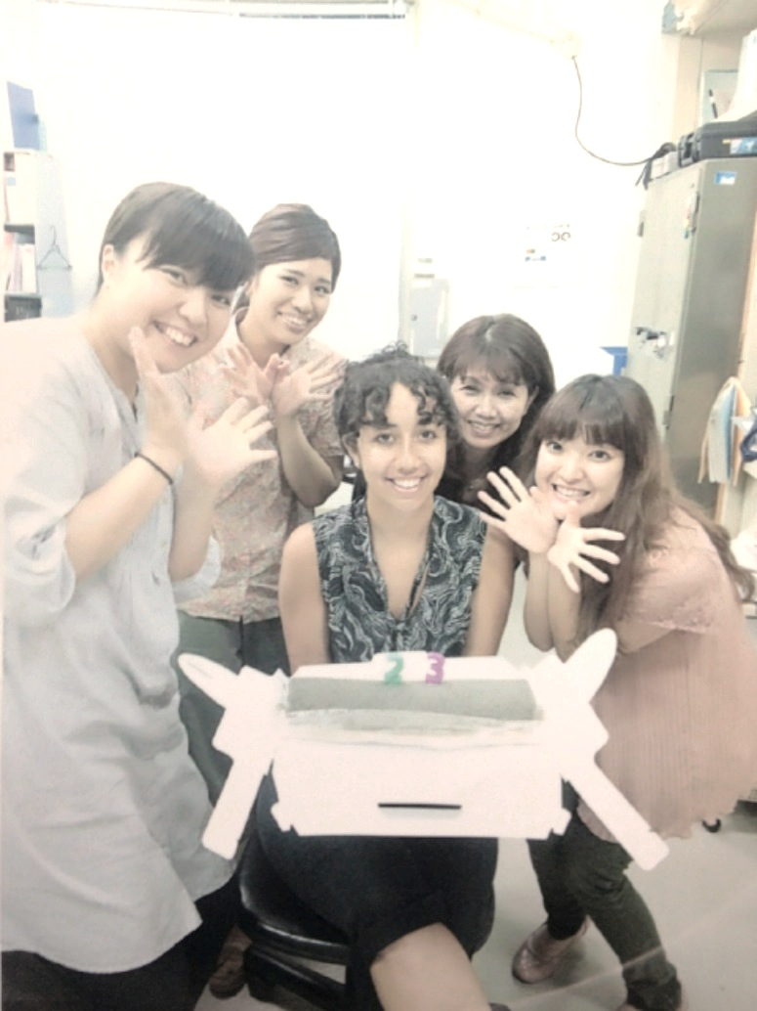
Ways to Enjoy Working at a Non-Academic SHS
Try to see your students doing what they’re best at
Get involved in after school activities
Do any of your co-workers want to learn English?

Slide 6
Ideas on Lesson Formats

Slide 7
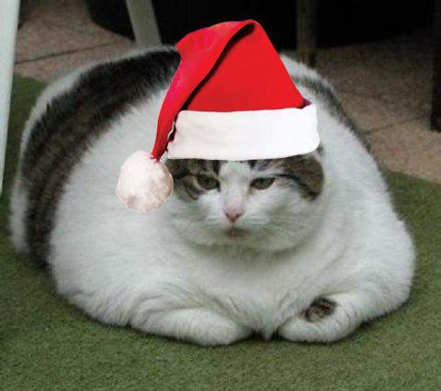
Christmas Lesson

Slide 8
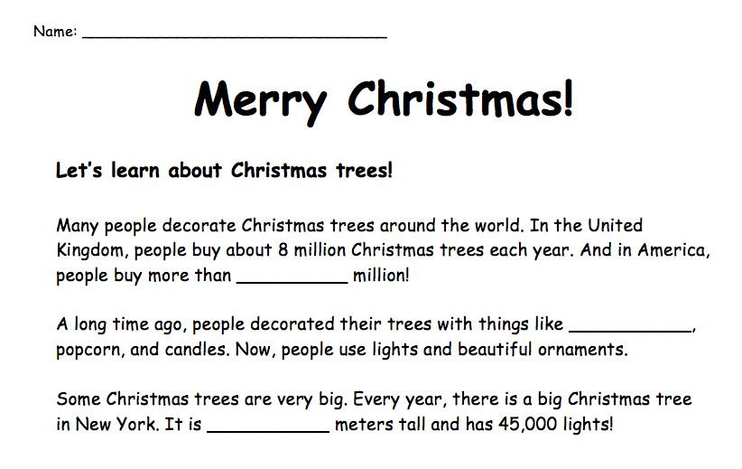
Ana
35
fruit
24

Slide 9
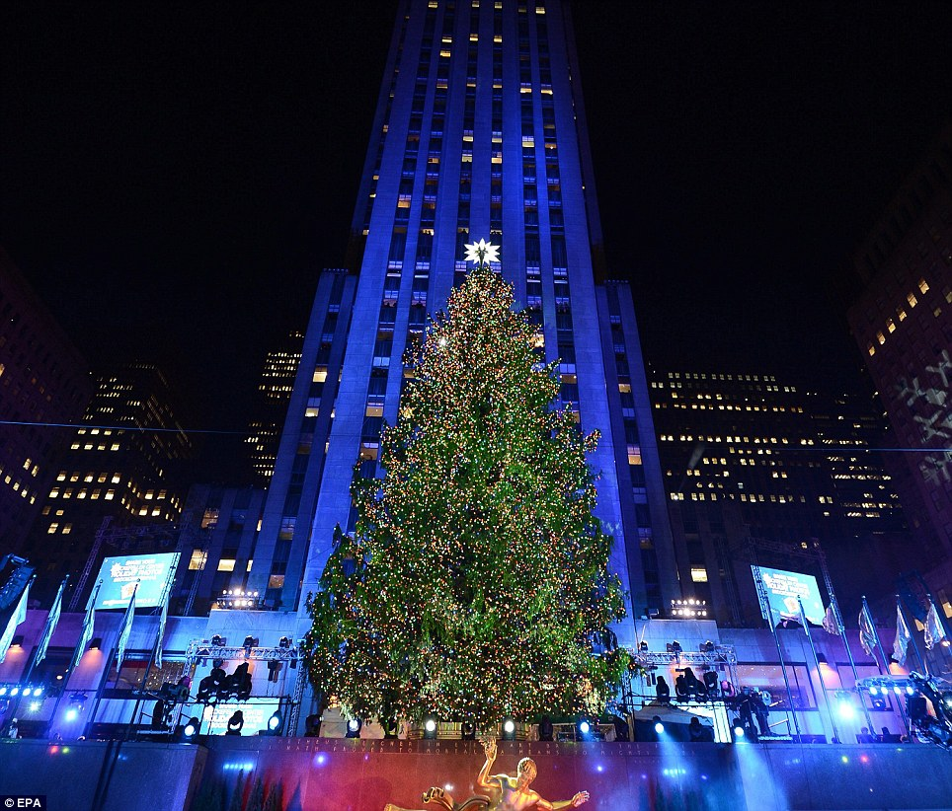

Slide 10






Christmas Vocabulary
1. candy cane
star
bell
2. __________________
3. __________________
キャンディーケイン
星 （ほし）
鈴 （すず）
ornament
angel
present
4. __________________
5. __________________
6. __________________
オーナメント
天使 （てんし）
プレゼント

Slide 11
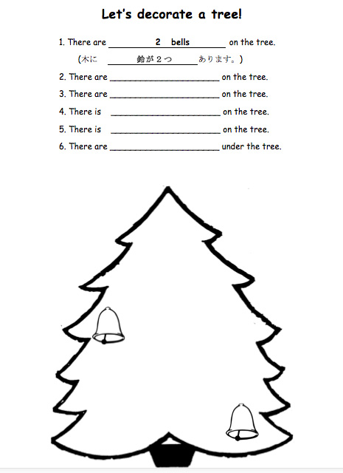

Slide 12

There are two bells on the tree.
( 木に 鈴が２つ あります。 ）

Slide 13
2. There are two candy canes on the tree.
( 木に candy cane が２つ あります。 ）

Slide 14
3. There are three ornaments on the tree.
( 木に ornament が3つ あります。 ）

Slide 15
4. There is one angel on the tree.
( 木に 天使が 1つ あります。 ）

Slide 16

５. There is one star on the tree.
( 木に 星 が 1つ あります。 ）

Slide 17

６. There are two presents under the tree.
( 木の下に プレゼント が ２つ あります。 ）

Slide 18
Let’s play a game!

Slide 19

7

Slide 20

2

Slide 21

1

Slide 22

12

Slide 23

6

Slide 24

8

Slide 25

10

Slide 26
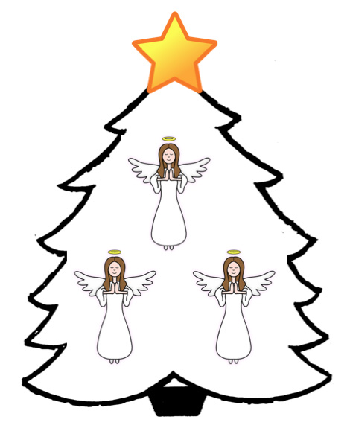
5

Slide 27

3

Slide 28

4

Slide 29
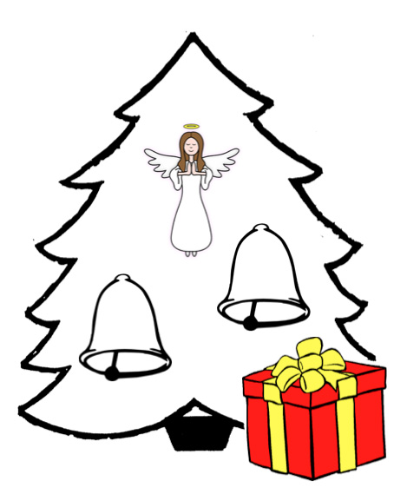
9

Slide 30
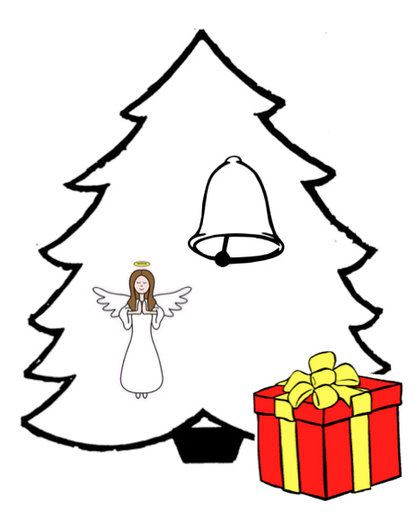
11

Slide 31
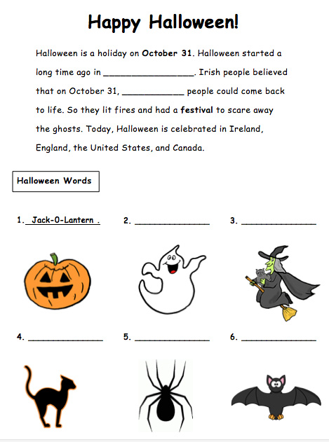

Slide 32
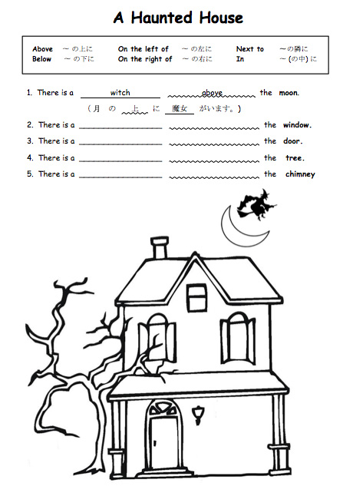

Slide 33
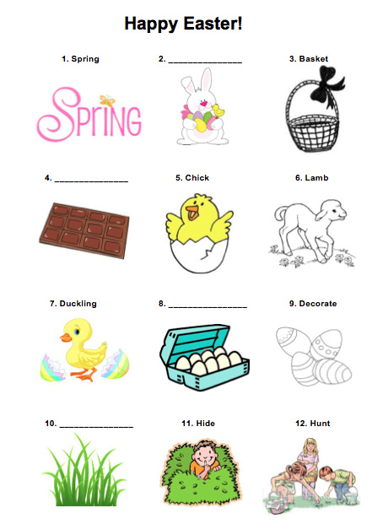

Slide 34
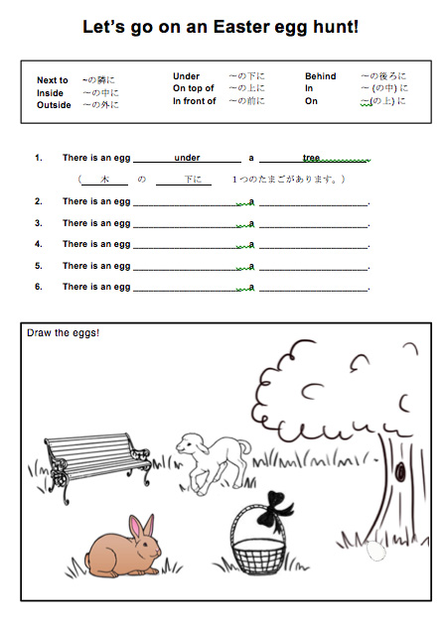

Slide 35
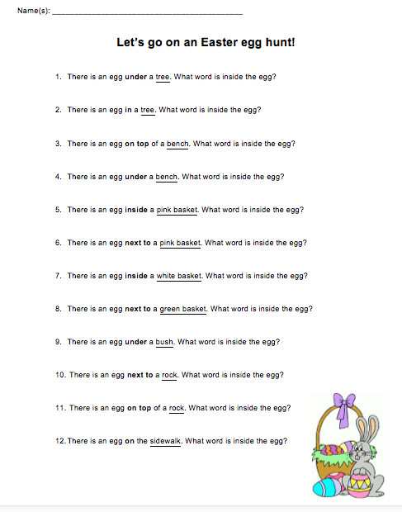

Slide 36

Mystery Box

Slide 37
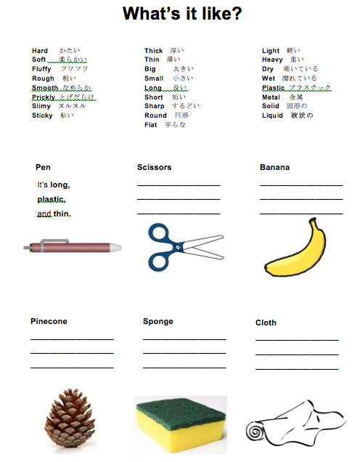
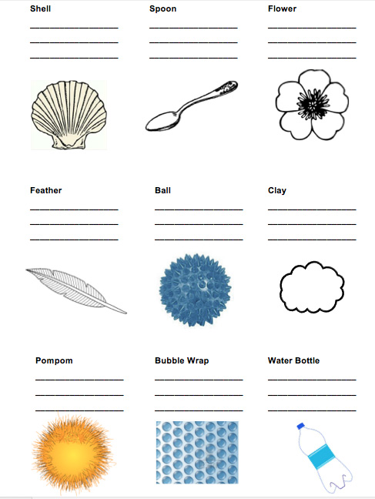

Slide 38
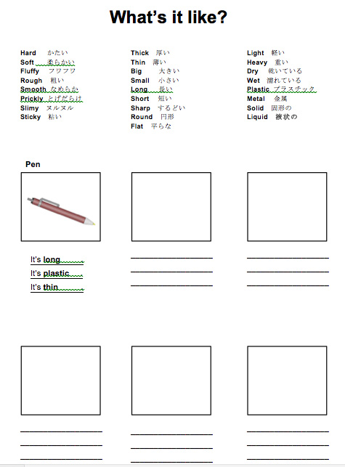

Slide 39
anaching2@gmail.com

