Slide 1
Women’s Issues
How to thrive as a Western woman in a Japanese workplace.

Slide 2
Self-introductions!
Katie Strong (so you don’t have to try and remember for the survey)
Notes:
- my self introduction: who am I and why am I here?
- Katie Strong, American, 2nd year Junior High School ALT in Motobu (in the north)
- who are you? get every one's names
- In this first year, my personal experiences, including issues ranging the gamut from objectification and sexual fetishization, othering, gender discrimination in the work place, and sexual harassment by students, and the related experiences of other people have led me to giving this presentation.
- As a community, I think it is important that we are united in facing these issues.
- In Okinawa, in particular, being a foreigner in Japan can be very trying. Being a foreign woman even more so. As JETs, it is our responsibility to help each others through this and provide support.

Slide 3
Goals
Set your own personal boundary for what is and is not acceptable
Learn how to recognize when that line has been crossed
Become acquainted with strategies for dealing with situations that may arise
Develop the ability to analyze and react to situations in a culturally appropriate way on your own
Provide a safe place for discussion
Notes:
- The danger in dealing with issues like this is extremism: it is not our goal (nor should it be) to right the gender inequalities of Japanese society. Neither should we aim to integrate into the society, although many JETs do try and do this. Grass-roots Internationalization is an aim of the JET program. Our mission is to thrive here, because happy JETs are effective JETs.
- Due to the time constraints of this presentation, I’ve had to focus it on the issues that we are likely to face in work environments. Issues of domestic abuse, harassment in public spaces, and sexual assault, while extremely important, will not be covered. However, some resources for these topics will be shared and as Women’s Issues liaison, I’m more than happy to discuss any of these topics privately at any time.
- Because many of these issues are extremely personal, this workshop needs to be a safe space. While sharing resources and strategies is encouraged, anything that a workshop participant says should stay within this classroom.
- Keeping that in mind, while I have stuff to talk about, this is a workshop not a presentation. I specifically asked to have a small number of participants so that we could talk. If at any point you have questions or comments, please speak up, I want this to be a discussion, not a lecture.

Slide 4
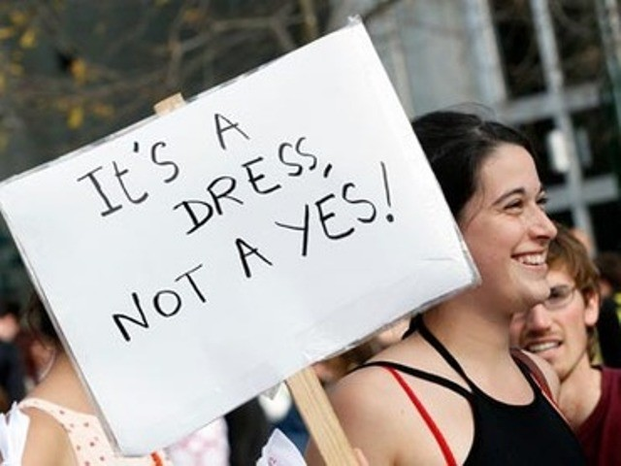
A brief legal history
1985 – Passage of Equal Employment Opportunity Law in Japan
1989-1992 – first sexual harassment lawsuit
1997 – first introduction of sexual harassment guidelines – EEOL revised to require employers to “give consideration” to sexual harassment prevention
90’s-00’s – Japanese society begins to transform
2007 – EEOL is heavily revised
Notes:
- 1985 - this was the first step towards gender equality in the workplace, however the language was very relaxed, did not include any sanctions, and therefore compliance was essentially voluntary
- 1989 - prosecutor sued under tort law (note, not the useless EEOL) for defamation when lies about her promiscuity were spread through the workplace. When she had complained, she had been told to be flattered. This is the case that introduced the term "sekuharu" into the Japanese lexicon. Won in 1992, despite being heavily contested. Today generally positive public view, but at the time heavily mocked.
- 1997 - however, the EEOL was still weak enough to be considered unusable. Tort law was still used for law suits. (Civil Codes)
- Despite this, other changes were being made. In the 90's and early 00's the Childcare Leave Law was expanded to cover both mothers and fathers, the Basic Law for a Gender Equal Society was written, anti child-pornography laws, domestic abuse and child abuse outlawed, marital rape finally recognized as a form of rape - women's centers begin to spring up all over Japan, with at least one per prefecture. Many of these changes have been due to pressure from outside of the country. The United Nations, in particular, has provided a lot of impetus. Legally, the country is transforming.
- 2007 - EEOL revised so that it looks like laws that we have in the US. Now mandates action, and has the teeth to back up what it says. Is used in legal proceedings to great effect.

Slide 5
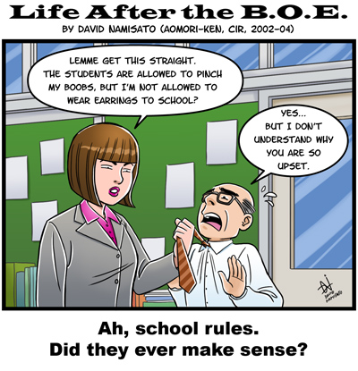
What does this mean for me?
YOU ARE
RIGHT!
Notes:
- Essentially, it means that YOU ARE RIGHT!
- legally, the law is on our side
- if something would be viewed as not okay where you are from, it is not okay here too.
- what we are fighting then is society, and a lack of understanding
- many people view the micro aggressions that make up male/female relationships in Japan as normal parts of office life, and therefore do not recognize them as sexual harassment
- however, once pointed out, they are likely to acknowledge and make efforts to make change
- our job then, is to figure out what to bear, what not to, and how to bring things to attention in a delicate way

Slide 6
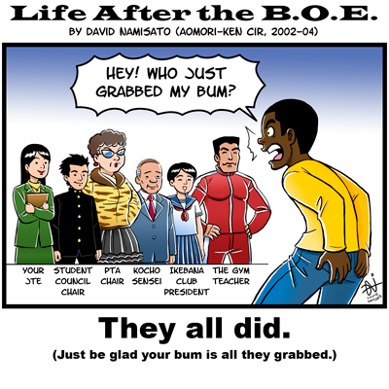
‘Is This Harassment?’ Game
Your boss addresses your male friend instead of you when he wants to ask you a question.
Your students comment on your appearance several times a day.
A coworker is prevented from sitting next to you because he has to sit at the “boys’ table”.
During class, when you walk over to help a student with their work, you see a drawing of an unclothed woman labeled with your name that they have been working on.
At a work party, your vice-principal gets drunk, and starts shouting that he loves you and begging you to come over and give him a hug.
Your students ask you about your bra size.
Notes:
- is this sexual harassment?
- no surprise, these are all examples of sexual harassment
- however, not all of these can or should be prosecuted
- it is worth noting that these actions can be done by both coworkers and students

Slide 7
Let’s Define: Sexual Harassment
Physical conduct: violence, contact, demanding sexual favors by making job-related threats
Verbal conduct: comments on your appearance, age, private life, and so forth. Sexual comments, jokes, or advances. Repeated social invitations (that are not desired). Sexist insults, and paternalistic or condescending remarks.
Non-verbal conduct: displays of an explicit nature, gestures, or whistling
Guideline: is the action unwelcome or unreasonable?
Notes:
- a lot depends on context
- different cultures have different standards (i.e. on what is normal and acceptable physical contact)
- the definition of sexual harassment is inherently subjective and individual, which can lead to the image that sexual harassment is a cry by women who want to "get back" at men. However! Inherently innocuous actions are protected and are exempt from the unwelcomeness definition.
- have everyone give an example of what they would consider sexual harassment
- as a final note, it is worth keeping in mind that we are at high risk of sexual harassment. being foreign, young, without a support network, minority, immigrant, and having a male supervisor (which many of us do) all increase the likelihood of experiencing sexual harassment.

Slide 8
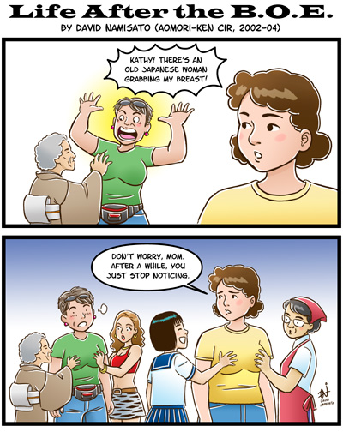
So, how do we deal?
First draw a line: What is and is not okay with you?
Notes:
- we need to be happy and healthy, we don't need to "fix" Japan.
- I drew the line at "positive comments about my physical appearance, non-sexualized comments about the otherness of my appearance (eyes, but not boobs), and occasional paternal condescension from those who I very rarely interact with is not worth the fight. Sexualized mentions of my body, touching of any kind, unwanted invitations, or gossip about my personal life were over the line.
- go around and ask people to think about where they want to draw the line and what they would do.

Slide 9
Okay or Not?
The bell rings for class to end, but your JTE is struggling to get the students’ attention so that they can bow and end class. In an effort to get them to look forward, she says “look at the beautiful person in class.” When the students then look forward, she says, “I know that if I said that, you would all look at [the ALT]”.
Notes:
My thoughts:
This was a tricky one for me. I felt exotified in this situation. I particularly dislike it when my appearance is made an issue. It feels almost dehumanizing, and like it undermines my authority as a person…I am reduced to my appearance. While this troubled me, I ultimately decided that it did not cross my line. My good relationship with my JTE was more important than this issue. While I did not address it directly, the next time a student made a comment on my appearance “your nose is so high! Your eyes, are they contacts?” I made a point to explain that it is just my nose, they are just my eyes, and that they are the same as theirs even though they look different. I explained that it makes me uncomfortable when people speak about my body that way. This conversation happened in front of the JTE, and I made sure that she was able to understand it. Since then those comments have ceased.

Slide 10
Okay or Not?
You arrive at class before your JTE does. While you are chatting with some students, you notice a group of boys gathering in a corner. When you look over, you see them staring at your chest and gesturing to it, while loudly discussing different fruit. After class, when you are leaving, they call you “melon” in the hallway.
Notes:
This one crossed the line for me. While I am hesitant to openly chide my JTEs, with students this is inappropriate. I told them loudly “no” and then in Japanese told them not to talk about me that way and that they were rude. I reported their actions to their JTE, who also reported it to their homeroom teacher. I also talked about it with the soccer coach, who is another JTE and a friend of mine. They got a warning the first time, but after it happened again, I told the same people, and there were severe repercussions, particularly in their club activities, since they played soccer. The bad behavior ceased. The important thing is to quickly take direction and clear action. The cause and effect has to be fresh in the students’ minds.

Slide 11
Okay or Not?
You have a new JTE, with whom you typically communicate in English. One day, he sees you studying Japanese at your desk during your break time. After that, he tells you that, while the English practice he gets speaking to you is useful to him in his job, you need the Japanese practice, so in order to help you, all future communication with him must be done in Japanese.
Notes:
For me, this was an example of extreme condescension. While it was phrased as something being done for my benefit, it was very paternalistic and diminutive, and demonstrated both a lack of respect for me and a lack of ability on the JTEs part. It did cross the line for me, because I had started to see these same dynamics playing out in the classroom.
I handled this one badly. I would cry in the bathroom after every class with this teacher. And while I am sentimental and tear up at movies and moving stories on the internet, I’m not the sort of person who cries over things that upset me. I should have addressed it, but I didn’t realize what was going on.
What I should have done was speak to other teachers about my issues with him. I had great relations with the other JTEs, who respected and appreciated me. If I had spoken to them, they may have been able to help me with this situation. Additionally, I should have put down my foot and explained that I was there to speak English, so I had to speak English. If I had phrased that politely, then there wouldn’t have necessarily been any ill will either.

Slide 12
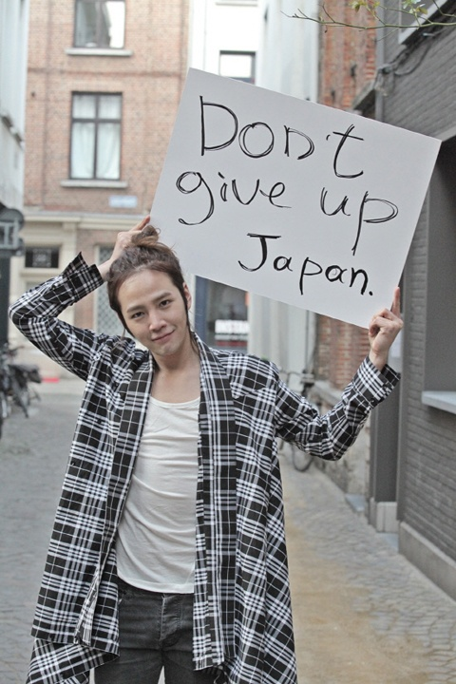
Strategies
Your JTEs are your liaisons
Don’t allow yourself to be silenced
Know your chain of command
Don’t be complicit
Gaijin smash! (no, really)
Finally, remember that you are a role model to your students
Notes:
- a lot of good strategies
- these are some of the ones I came up with
- our JTEs know that a happy ALT is an effective ALT. For the most part, they are on our side and want to help us. They are also more likely to have experience with your culture, which means that they will more easily see your side
- We aren't perfect at Japanese culture, that's expected. Don't assume that something is culturally normal, and therefore "okay". If it makes you uncomfortable, it is not okay, regardless of whether or not it is the cultural norm here.
- If you want people to help you, don't embarrass them. Work up the chain of command, starting with the closest to the incident. However, if the first person doesn't do anything, don't be afraid to go over their head. Your comfort is most important
- we are a community. If we see this happening to anyone else, we need to stop it. Don't be a bystander.
- We get told a lot to not gaijin smash, this is a time where it is okay. You can preface everything with "In my culture…" in order to bring up issues in a gentle way. You are foreign, and you are here to be foreign, and this is one case where not adapting is not a bad thing. It softens the blow and alleviates blame, which can help to smooth out workplace relations, while also providing reinforcement for your views.
- your students look up to you, not only as a teacher, but also as a representative of your nation and of the world outside Japan in general. Think about how you would want your female students to be treated when they get older? If you wouldn't want that for them, then don't take it for yourself. Stand up for how you want. Grass-roots internationalization can and does start with JET, and that can and does include a steady movement towards gender equality.

Slide 13
Who do I talk to if…?
Your JTEs and Supervisor are your best school resource.
Okinawa Support Network: Women’s Issues Representative – this year, me. 080-6494-9911
Okinawa PAs – Elizabeth in particular has experience dealing with these issues and knows channels to take
CLAIR JET Line – 03-5213-1729
Tokyo English Life-line – 03-3498-0261
JET Peer Support Group – 050-5534-5566
沖縄県女性相談所 – 098-854-1172
女性の人権ホットライン – 0570-070-810
Notes:
Resources listed in Japanese are available in Japanese only

