Slide 1
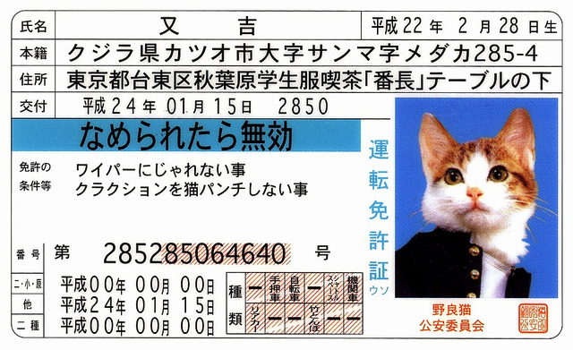
Converting to a Japanese
Driver’s License

Slide 2
Tips Before Starting
Start the process early
Plan to use nenkyuu
Plan to spend some money
It helps if you know some simple Japanese
Prepare yourself to be frustrated
Try not to have a bad attitude

Slide 3
The Paper Application
Process

Slide 4
Necessary Documents

Slide 5
Step 1: Getting your license translated
You will need:
  An application form from JAF

Slide 7
Step 1: Getting your license translated
You will need:
  An application form from JAF
  A copy of your driver’s license (both sides)
  *A copy of your alien registration card (both sides)
  Translation fee: 3,000 yen

Slide 8
Step 2: Getting a Certificate of Residence
A Certificate of Residence can be obtained from your City Hall
Ask for a 外国人登録原票記載事項証明書
（gaikokujin touroku genpyou kisai jiko shoumeisho)

Slide 9
Step 3: Taking your complete paperwork to the Driver’s License Center
Take the following things to the Driver’s License Center in Tomigusuku:
  Original license and a photocopy (both sides)
  Alien Registration Card
  Passport and copies of the pages with your name, visa, and date of entry into Japan
  Two standard ID photos
  JAF translation of your license
  Certificate of Residence
  About 5,000 yen (this will vary depending on your citizenship, but is generally 2,400 yen)

Slide 10
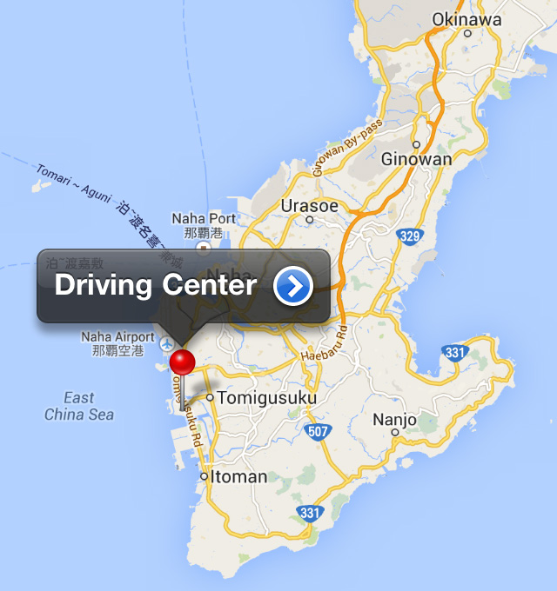
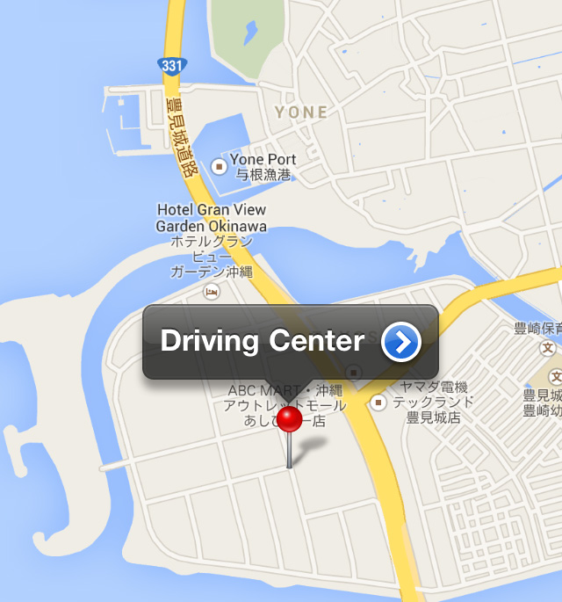
Getting to the Driver’s License Center
The Driver’s License Center is in Tomigusuku
On the bus:
  You need to get off at Michi no Eki Toyosaki
  You can take the 55, 56, 88, or 98 from Naha

Slide 11
At the Driver’s License Center
Take your documents to the Driving License Center on a weekday between 8 am and 12 pm
See if there is a Japanese person who is willing to go with you
If your documents check out, you will be allowed to make an appointment to take the written test

Slide 12
The Written Test
You can only take the written test on Wednesday mornings
10 true or false questions
If you pass, you will be asked to decide whether you will take the test in a manual or automatic vehicle

Slide 13
The Practical Test
After passing the written test, you can schedule a road test
You may have to wait a few weeks for an opening

Slide 14
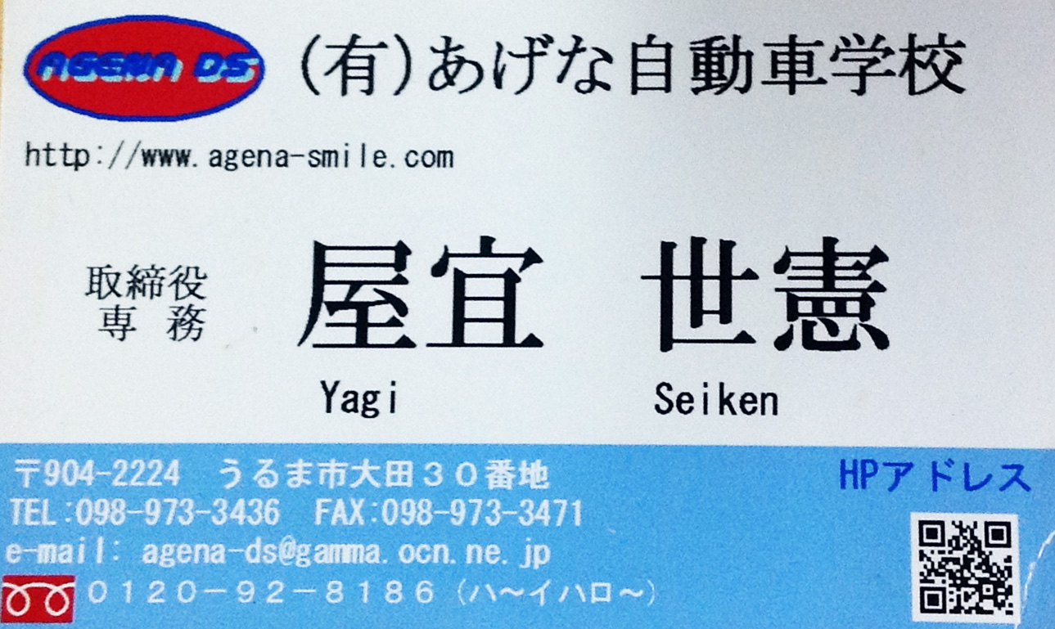
Driving School
One hour will cost about 5,000 yen
The driving instructor will likely only speak Japanese

Slide 15
A Walkthrough

Slide 16
Practical Japanese
Turn （曲がる magaru）
Left （左 hidari）
Right （右 migi）
Please turn left （左に曲がってください hidari ni magatte kudasai）
Turn right （右に曲がってください migi ni magatte kudasai）
Stop (止まって tomatte）

Slide 17
Practical Japanese
One （一 ichi）
Two （二 ni）
Three (三 san）
Four （四 yon）
Five （五 go）
Six （六 roku）
Seven （七 nana）
Eight （八 hachi）
Nine (九 kyuu）
Ten (十 jyuu）
30 km （三十キロ sanjyuu kiro）
40 km （四十キロ yonjyuu kiro）

Slide 18
Before the Practical
You will wait in a group with your fellow test-takers
A driving instructor will explain the procedure to you (probably in Japanese)
The driving instructor will call names and announce the test order
You will head out to the driving course as a group

Slide 19
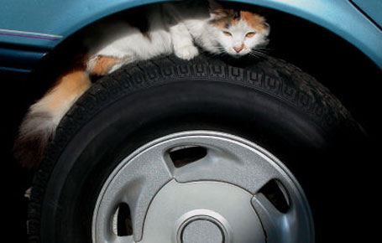
Before Entering the Vehicle
Walk around the outside of the car and check to make sure everything is okay.
  Look at the license plate
  Look at the tires
  Look under the vehicle to make sure there are no animals, people , or pointy objects.

Slide 20
Getting Set
After entering the vehicle, you need to:
  Adjust your seat
  Put your seatbelt on
  Adjust your rearview mirror
  Step on the break and start the ignition
  Put the car into drive and release the hand break

Slide 21
Heading Out
The car will be parked along a curb and you will likely be heading out to your right.
You need to:
  Put your blinker on
  Head-check over your left shoulder
  Check your left mirror, middle mirror, and right mirror
  Head-check over your right shoulder
  Check your middle mirror again
  Pull out

Slide 22
Straightaways
There will be straightaways where the driving instructor asks you to bring the car up to 30 or 40 km/h
Bring the car up to speed as fast as possible
Keep the car as close to the speed limit as possible

Slide 23
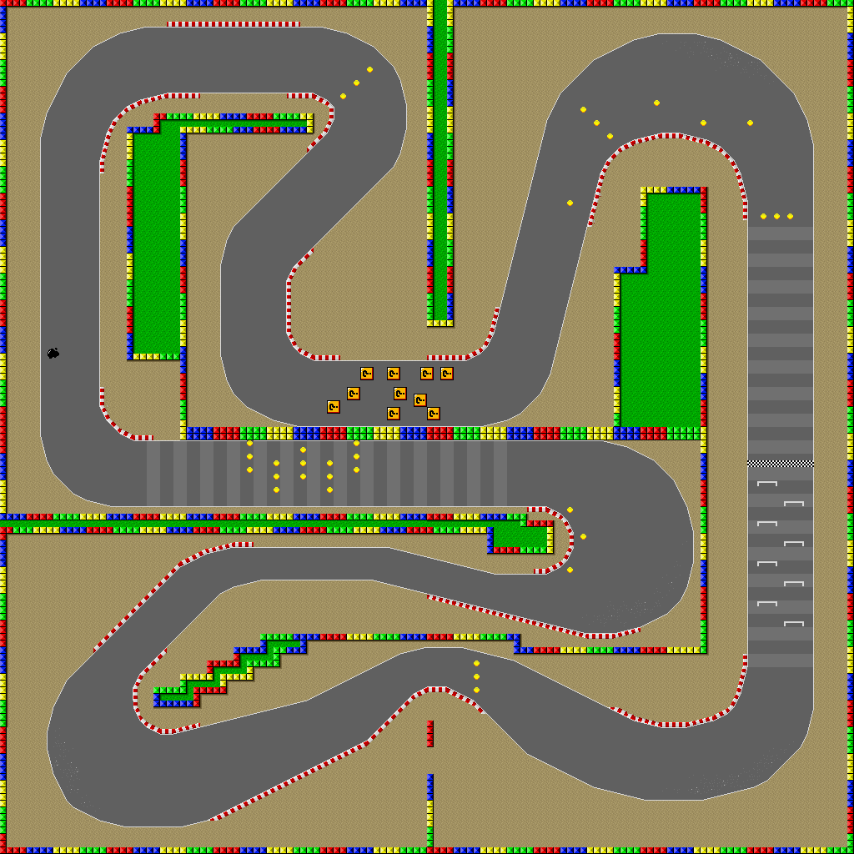
Large Turns
Coming out of the straightaway, you will approach a large turn.
As you go into the turn, you need to slow down by pumping the break 2 – 3 times.

Slide 24
Changing Lanes/
Turning at Intersections
You need to:
1. Check your middle rearview mirror
2. Blinker
3. Check the left or right mirror, depending on which way you are turning
4. Check over your left or right shoulder
5. Check your middle mirror again
6. Change lanes/ Turn

Slide 25
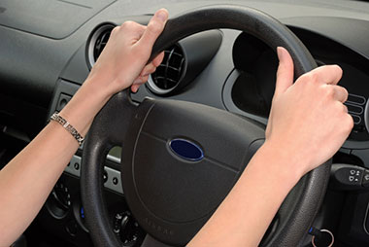
Turning Tips
Use both hands
Do not grab the inside of the steering wheel
Do not swerve outwards to the opposite side before making a turn

Slide 26
Crank Turns
Really bendy roads with very sharp turns
You need to:
  Go VERY SLOWLY (no one is timing you)
  If you run up over the curb:
    STOP
    Do mirror and shoulder checks
    Reverse the vehicle
    DO NOT CONTINUE DRIVING STRAIGHT OVER THE CURB

Slide 27
At a Stoplight or Stop Sign
You need to:
  Approach slowly
  Come to a complete stop
  Alternately check right and left
  Continue to check right and left as you move slowly into the intersection
  If there are walls or other obstacles obstructing your view to the left and/or right, lean over your steering wheel as obviously as possible as you check left and right.

Slide 28
Finish!
When you reach the end of the course, the instructor will ask you to pull back up to the curb by a numbered sign.
You need to:
  Bring the car as close to the curb as possible. It should be within 30 cm or fewer.
  Bring the car in line with the numbered sign.
  If you are too far away from either the curb or the sign, you will lose points.

Slide 29
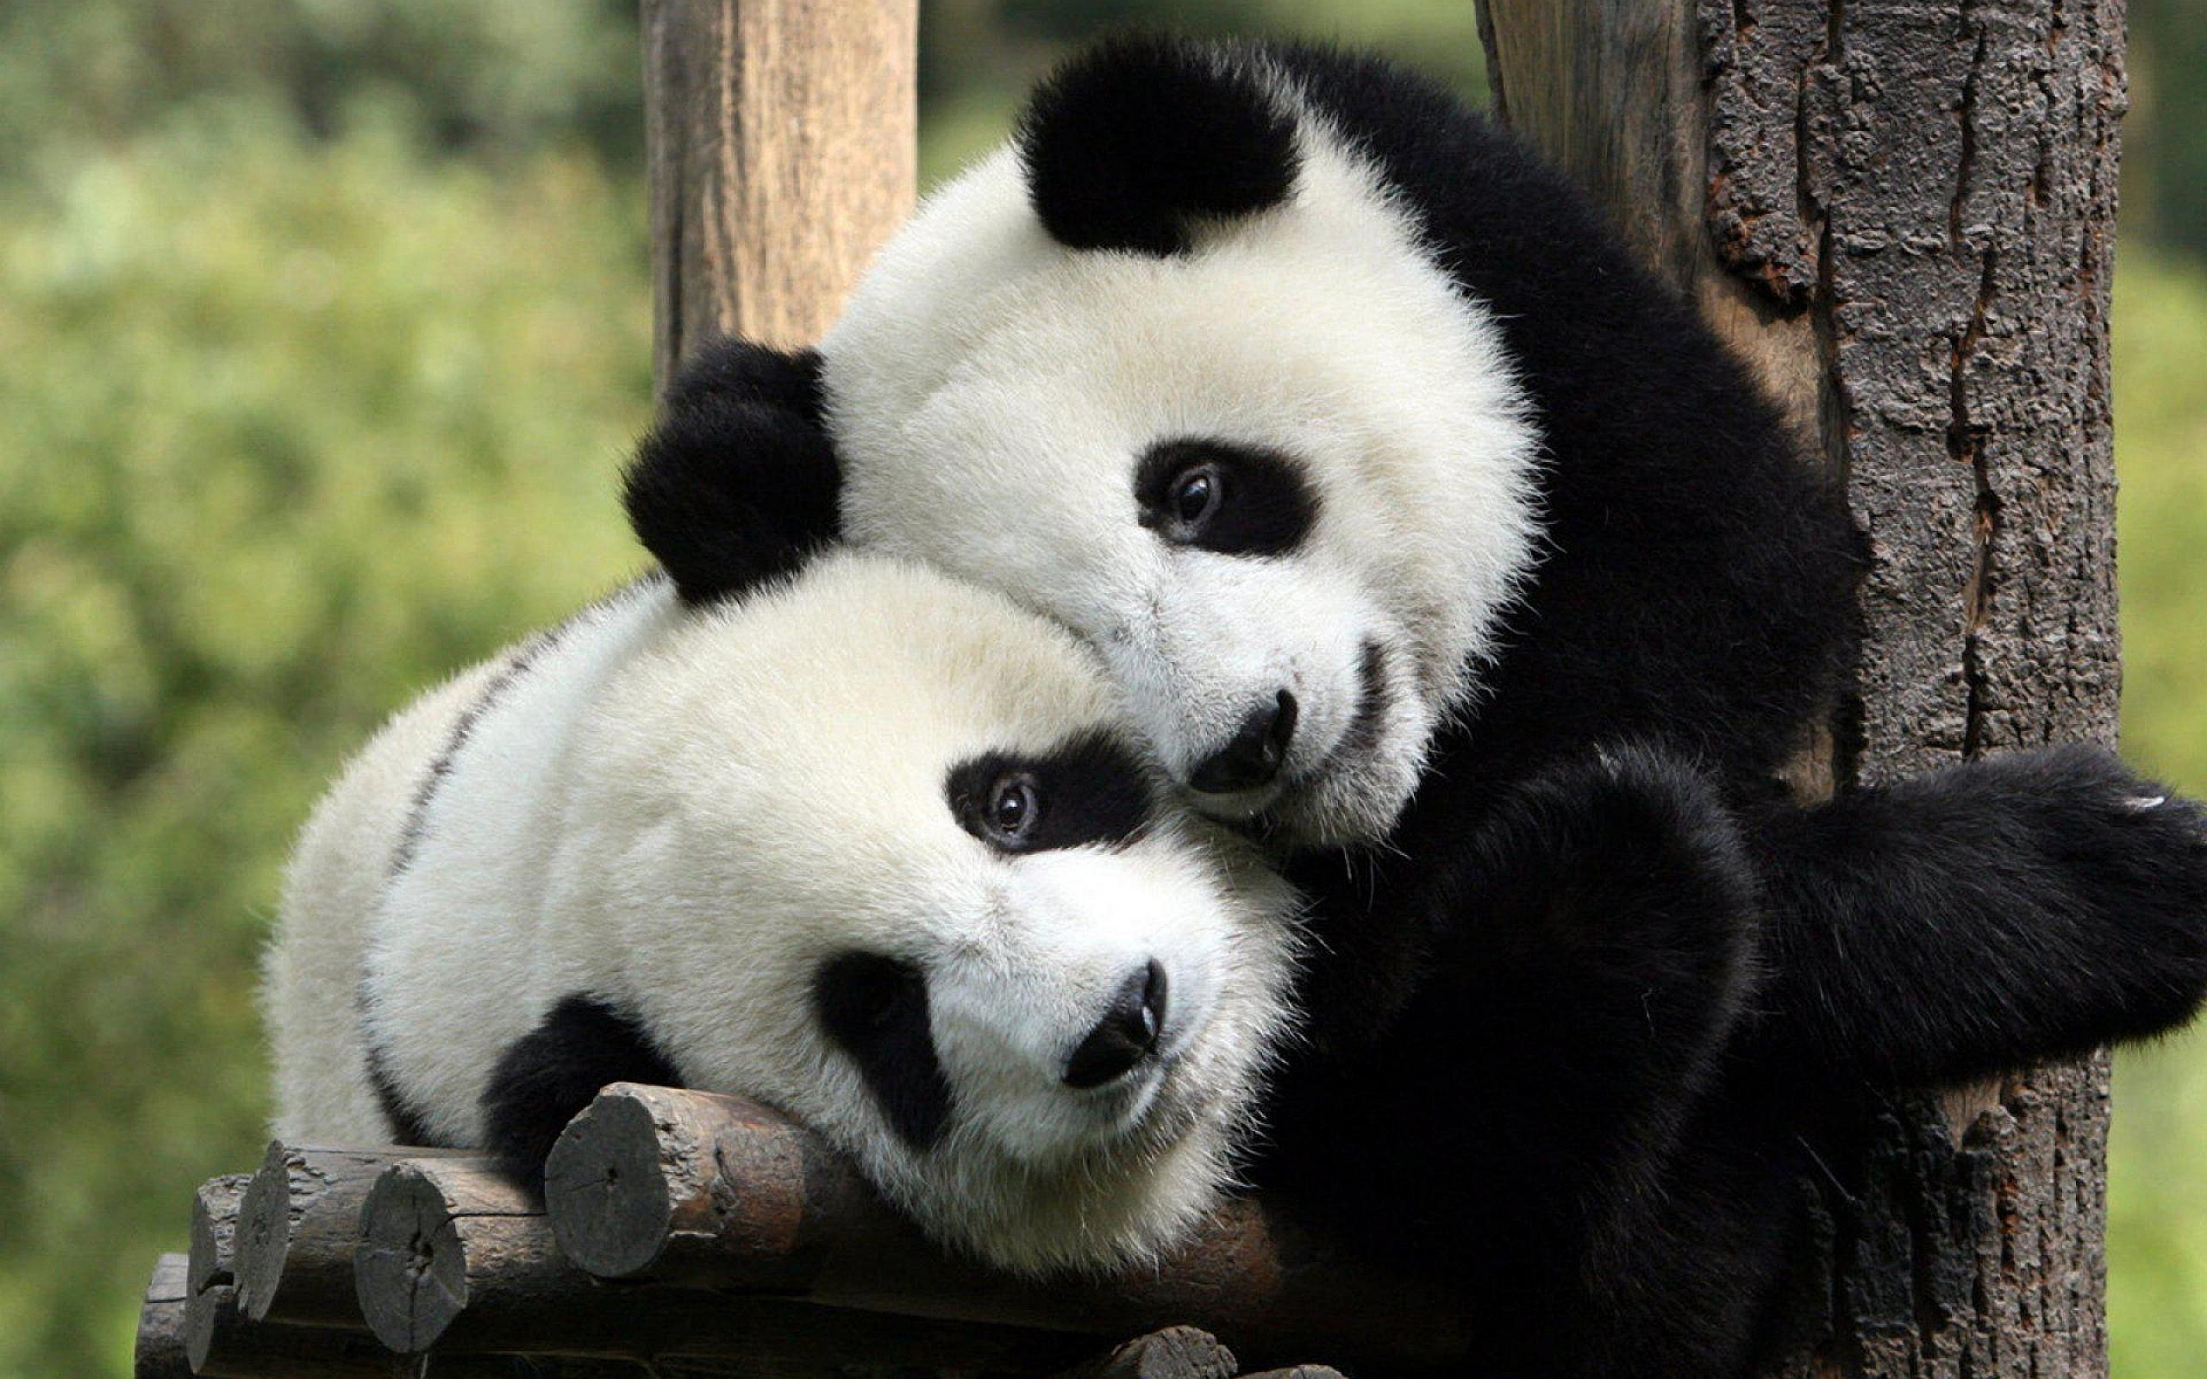
If you fail…
Don’t worry about it!
Many people fail on their first or second attempt
You may have to wait two weeks before you are allowed to re-take the exam
Cheer up, friend

Slide 30
When you pass…
Congratulations!
You will need to go back into the driving center to complete your paperwork and pay for your license
You will need to take an eye exam and have your photo taken
You may have to watch an instructional video before you are allowed to leave
You may be asked to pay an additional 1,000 yen contribution to the Okinawa “Safe Driving Fund”

Slide 31

Eye Test
Up （上 うえ ue ）
Down （下 した shita ）
Left （左 ひだり hidari ）
Right （右 みぎ migi ）
Yellow （黄色 きいろ kiiro ）
Blue （青 あお ao ）
Red （赤 あか aka ）

Slide 32
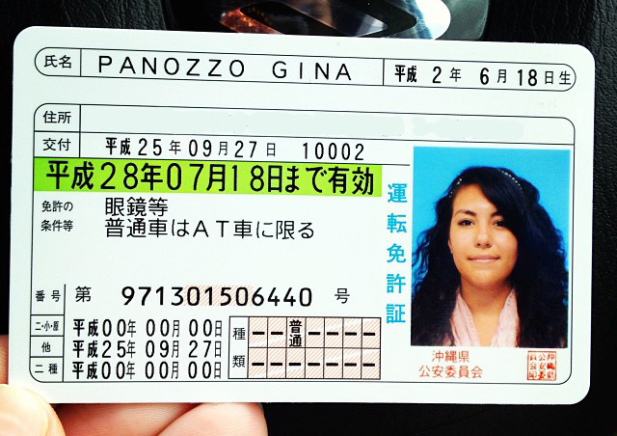
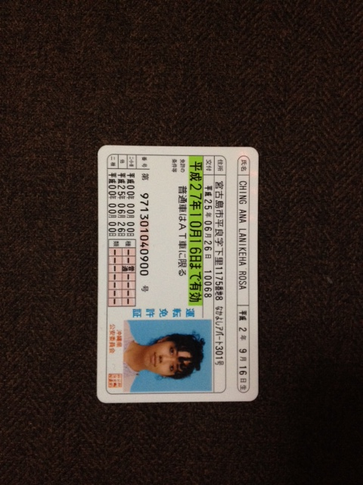
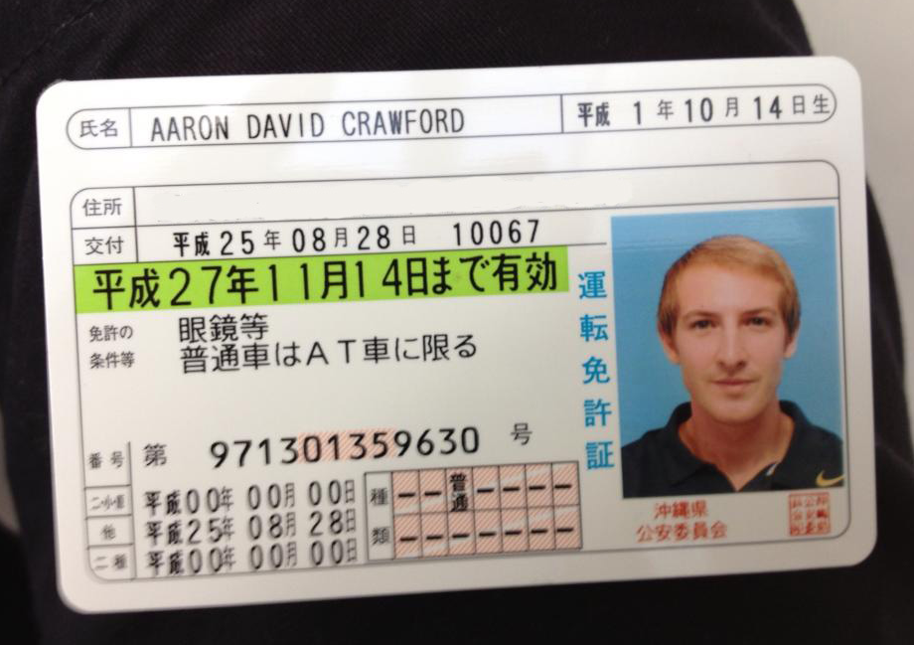
Congratulations!

Slide 34
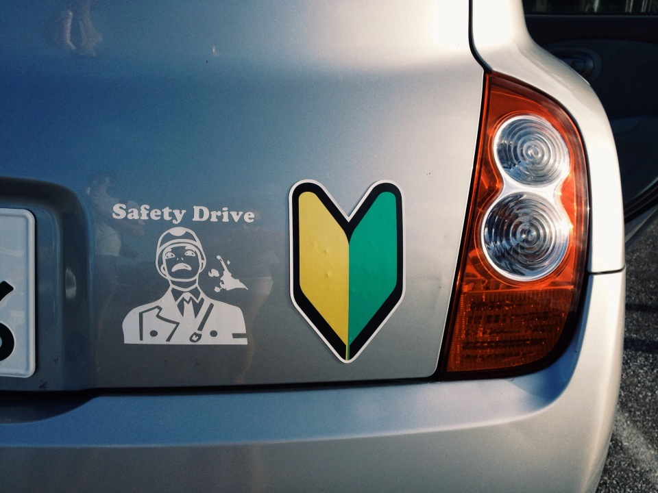

Slide 35
anaching2@gmail.com

