Slide 1

After JET ...

Slide 2
“I made plans and dates to catch up with all the people I wanted to before I left. It takes a long time, so I’m glad I started early. I’m also glad I organized what I wanted to do when I got back home. I began studying right after the summer. That kept me from getting lost in the transition of it all.”
“KEEP TRACK OF YOUR SCHOOLS’ ADDRESSES AND FAX NUMBERS!”
“I should also have done more regarding a job when I got home. I should have done more research on that”
“Get help writing your farewell speech. It may be the last thing people hear you say. Leave a good impression.”
“Take stock of your skills. Think of what you have learned. Make a list of what you DON’T want to do with your life”

Slide 3
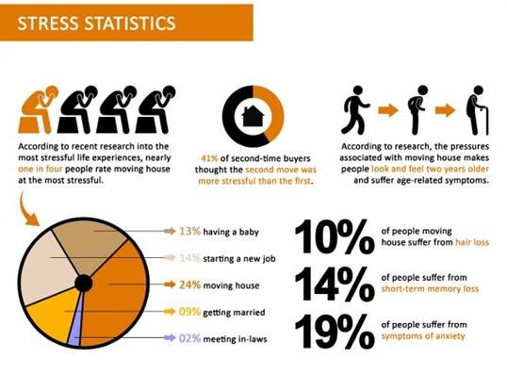
Moving + New Occupation= 38%

Slide 4

Reverse Culture Shock
Be aware of it
  You’ve changed, so has your home
  Idealized version of home
  You can’t always pick up where you left off
  People want Japan in a nutshell
  Join JETAA + other groups
  A little downtime is OK.
Notes:
2010 JETAA Survey 65.7%
Disengagement, initial euphoria, Irritability and hostility, Readjustment and adaptation.

Slide 5

Checklist Overview

Slide 6
Leaver's Checklist START NOW (8 mths)
JOB
Successor: Living Guide & Working Guide UPDATE NOW
Spring Clean Desk & Files (Paper & PC)
Plan Goodbye Gifts/Cards
YOU
Saving money
Japan Bucket List
Home/Next Destination Networking (Job-hunt)

Slide 7
Leaver's Checklist START FEBRUARY (6 mths)
JOB
Get reference letters & Write farewell speeches/letters
Return Ticket (Special Requests: tell your PA ... A.S.A.P)
Successor: New staff "Who's-Who" & "Selling" Inventory
YOU
Apartment Clearout (Sell / Recycle /Surface Mail)
Start serious Job-Hunt
MARCH Start "Goodbyes" (former colleagues etc)
Notes:
S

Slide 8
Leaver's Checklist START JUNE (2 mths)
PAPERWORK
Flights + Check Passport & Visa expiration
Pension Refund
Criminal Background Check (for future)
BANK 30,000-40,000 on deposit (? closing & transfers)
APARTMENT Give notice to agency (? deposit conditions)
SERVICES Pre-check how to end a contract (insurance/net)
HEALTH Dental check-ups etc.

Slide 9
Final Checklist end of contract/last days
APARTMENT Deep-cleanse for Shikikin (security deposit)
UTTLITIES Cancel and pay last bills/leave enough in bank
BANK P.O.A.+ inkan + 40,000 on deposit (seriously!)
PENSION REFUND Need a guarantor in Japan
POST OFFICE 6-month forwarding address
GARBAGE environmentally-friendly please!!!
PAPERWORK PAPERWORK PAPERWORK

Slide 10

PART 1
What you leave behind...

Slide 11

After JET ... Your ALT Legacy
Notes:
S

Slide 12
Discussion: Welcome Pack Do's & Don'ts
1. General Orientation & Living info
2. Supervisor Checklist
3. Workplace Orientation
4. JOB SPEC & advice

Slide 13
1 Orientation (General)
MAP of area with locations of note identified (incl. diasaster meeting point)
SETTLING-IN CHECKLIST (for August)
TRASH schedules and recycling explanation
APPLIANCE INSTRUCTIONS (A/C, microwave)
TRANSPORT Rules of the Road /Public transpt. schedules
EVENT LIST Year-at-a-glance
Your contact info

Slide 14

2 Guidelines for Supervisors
ALT-Recommended Checklist:
wishlist...

Slide 15
2 Guidelines for Supervisors
ALT-Recommended Checklist:
What an ALT really needs (first day/week/month)
Cultural Expectations
Admin: Inkan/Nenkyu/Byokyu/Travel Claims/Insurance
Recommended Bank account/ Phone network
Disaster Procedures / 119
Contacts / Emergency/ Next of Kin

Slide 16
3 Workplace Orientation
MAP of School(s) with locations of LL Room, Teachers changing rooms, Student Clubs etc
STAFFROOM/OFFICE Seating Plan with location of ALT mailbox, locker, teaching resources, keys etc
JTE Details (get them to fill out a questionnaire +photo)
LL Room User Guide
IT Resources available to ALT (PCs/colour printers etc)
TO DO Lists for August/Sep (incl. SDC hotel reservation)

Slide 17
4 ESID JOB SPEC
> only you know how to describe it in the language a new-comer can understand
> if this particular job was advertised... what would the bullet points be in terms of Roles and Responsibilities?
> What's mandatory? What's desirable? What's not applicable?
> What "Target" can be met?
GOLDEN RULE: Be positive but realistic (or at least neutral)
Notes:
S

Slide 18
4 ESID JOB SPEC > only you can describe it
GOLDEN RULE: Be positive (or at least neutral)
School Description & Year-at-a-glance (events & hols)
Student Body Description (ability/particular challenges)
JTE planning & TT preferenceses
Summary of ALT Monthly Schedule (& samples)
Job Requirements (Mandatory, 'Desireable' and N/A)
Your best, FAIL-SAFE lesson plans + handouts/materials
Your TERM PLANS for each school/grade/class (incl. what you covered up to July)

Slide 19
Your last 6 months...
will be forward-looking

Slide 20
Hit the ground running
After JET conference
After JET schooling? (start prep a year in advance)
JETAA
Get reference letters now (before April)
Update resume now
  (http://www.jetresumes.blogspot.jp/)

Slide 21

After JET ... CLEARING OUT

Slide 22
Selling it
General Tips
Start Early
Price Fairly
Consider pricing individually
Where to Sell
Facebook
OkiJET?
Yahoo! Auctions

Slide 23
Shipping it
FedEx
  Flat Rate 10 & 25kg boxes.
  25KG ¥25,800 (Oceania) ¥35000(US), ¥38,000 (UK)
Japan Post
  Maximum insured value ¥27,000
  Surface mail (1-3 months) ¥500/kg (World)
    10% discount for 10 packages, 20% for 50 packages sent concurrently.
    Double walled boxes & other materials
    M-bags can send up to 30kg of printed matter
    Sports Equipment
      SAL (1-2 weeks) ¥1000/kg (World)
Kuro Neko Yamato (UPS)
  25kg 160cm ¥26050 (USA/Oceania) / 30,450 (UK)

Slide 24

Junking it
When in doubt, throw it out.
Don’t leave stuff behind for your successor without explicit permission. (Toiletries, spices, etc)
For larger items talk to your supervisor, consider borrowing a car to transport to dump.

Slide 25

Disposing of a car
Previous venues for selling
Selling to a dealer
Junking it (Shakensho, hanko and shoumeisho, recycle ken)

Slide 26
Unplugging
CONTRACTS Cancel cellphone early if you can. Needs to be done in person. Consider prepaid for last month
UTILITIES Find out what to cancel (Elec, Gas, Water)
  Leave money in your account to cover final bills (approx ¥50,000)
PAPERWORK Save or make copies of bills so that supervisor will them to reference if questions come up after you leave.

Slide 27
Tickets
ESID
  Cash / Ticket Provided / Reimbursement
  Don’t buy your return ticket before getting approval!
  Baggage allowances have changed.
    American Airlines, Asiana, Korean
  Sports equipment cheaper to fly home than ship

Slide 28

After JET ... FINANCES

Slide 29
Your last paycheck...
May or not be the full amount
you can
you cannot get paid earlier (Group B JETs)
start SAVING now (moving costs are more than u think!)
Leave money in your account for:
Utilities
Resident's Tax (for 3rd year Plus JETs)
Notes:
* for 3rd year plus JETs, for 1st and 2nd year JETs may be different

Slide 30
Pension Refund It's all about the Fukuzawas
How much?
1 year (12 mos.) ~280,000 JPY
2 years (24 mos.) ~560,000 JPY
3 years (36 mos.) ~840,000 JPY
3 years (36+ mos.) is the cap for pension refunds, consider the pension payments in your 4th or 5th years a contribution to Japan’s doomed pension system. Trust me they need it.
Notes:
* for 3rd year plus JETs, for 1st and 2nd year JETs may be different

Slide 31
What you’ll need:

Slide 32
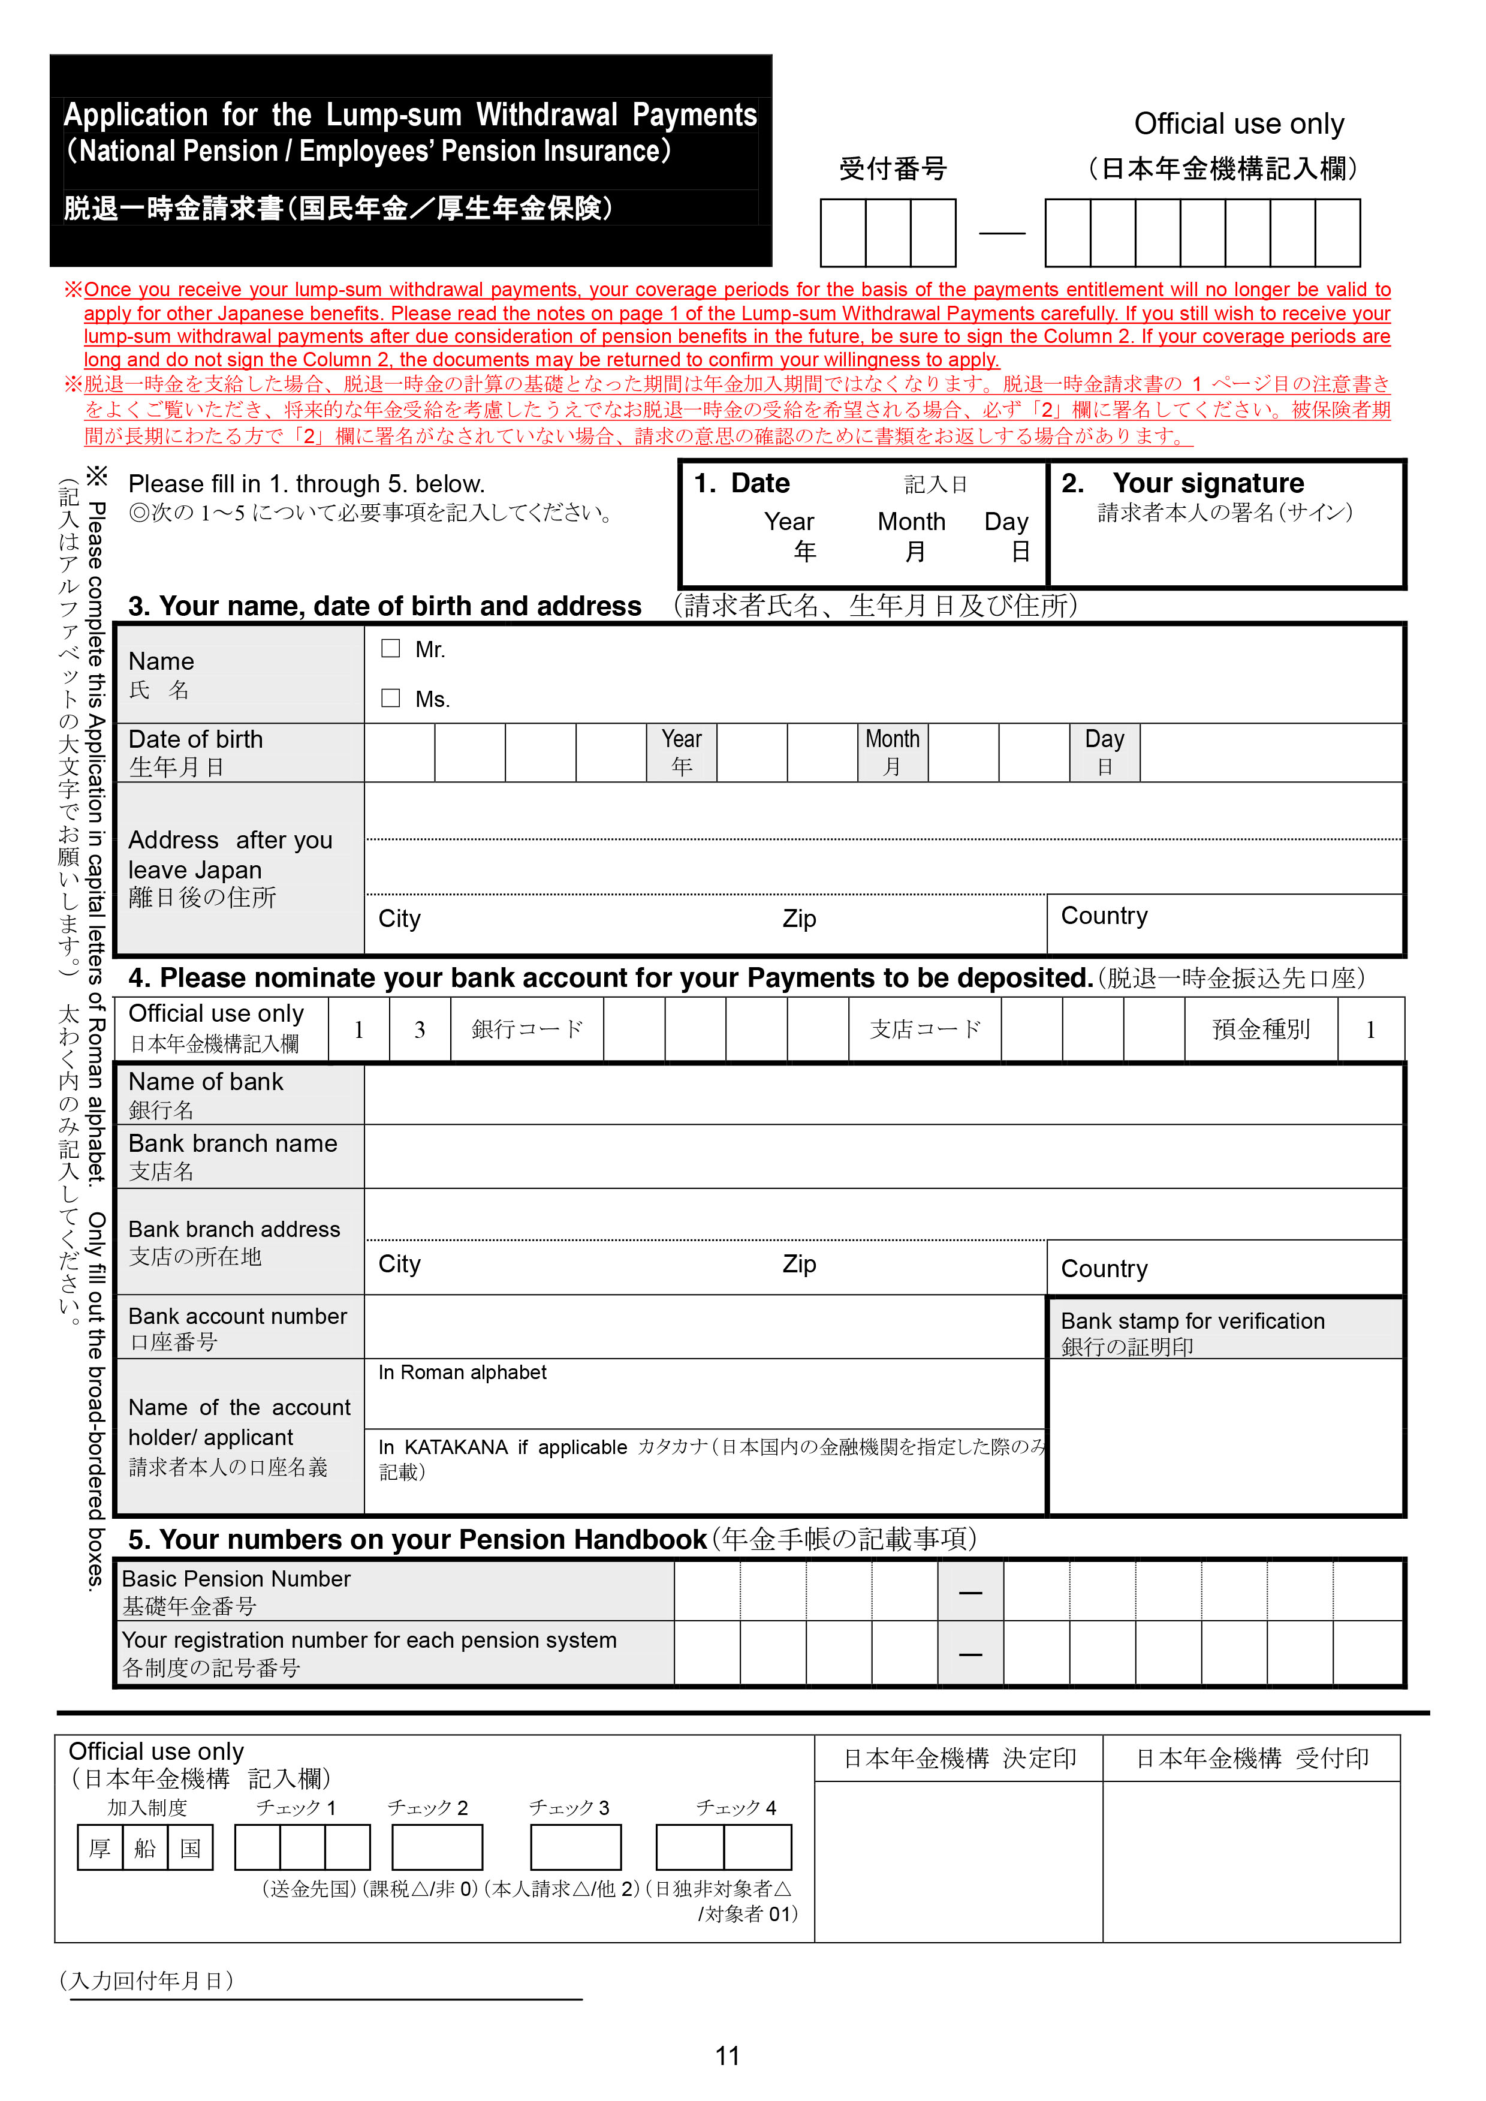

Slide 33
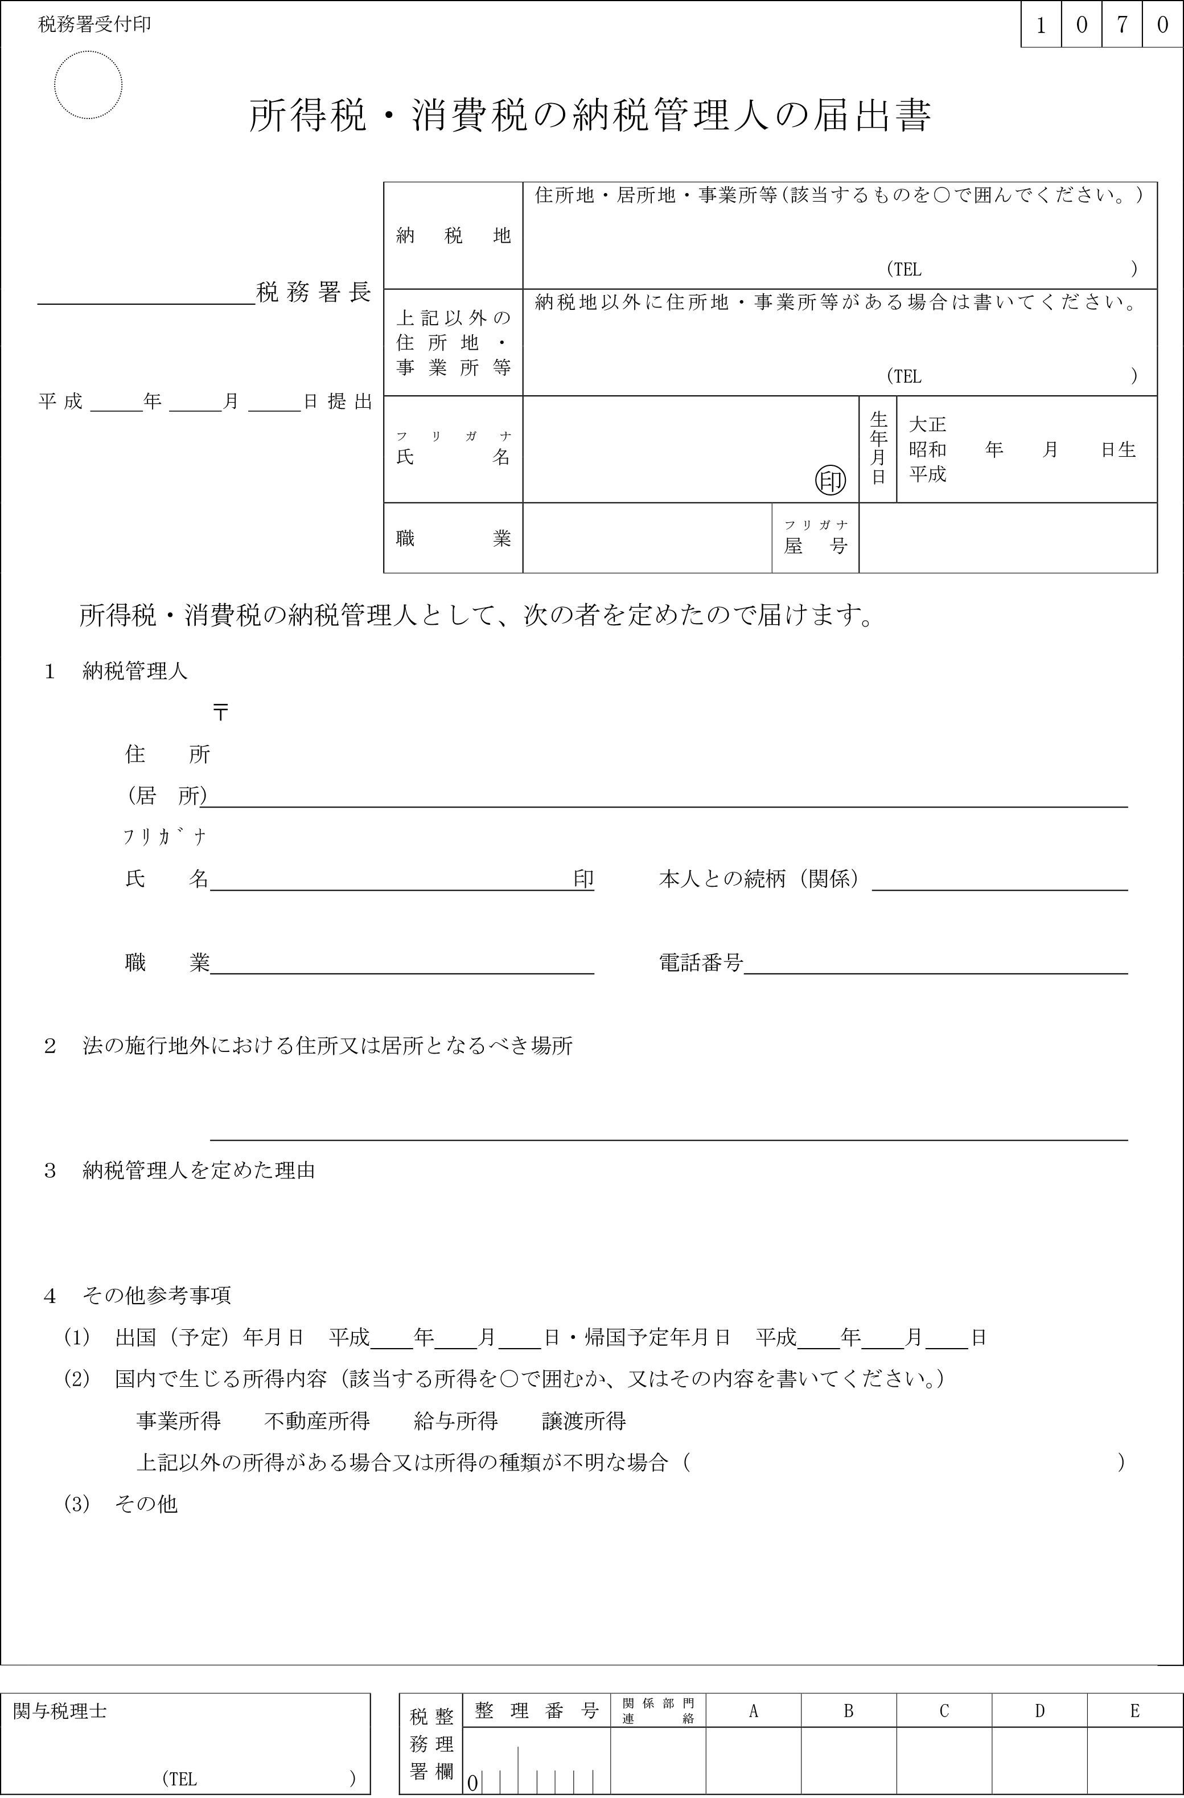

Slide 34
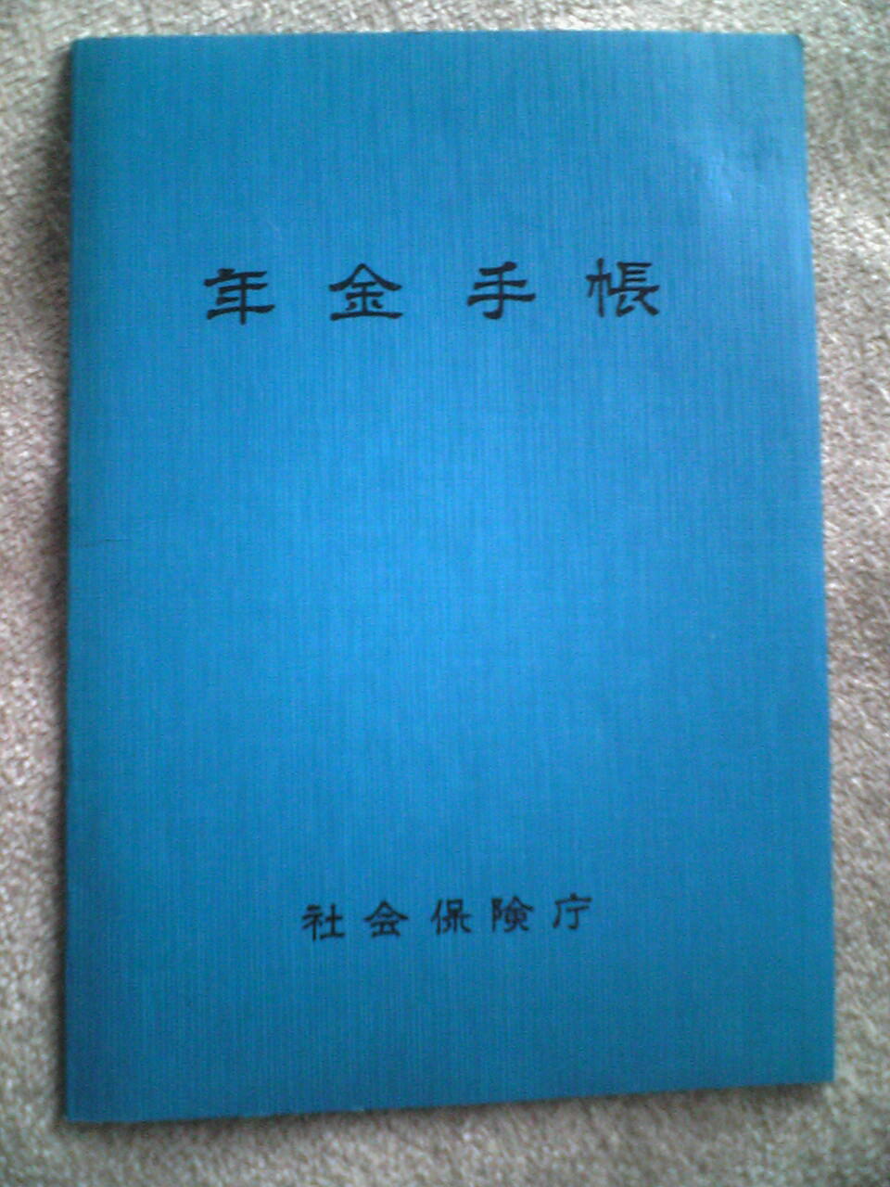

Slide 35
Before leaving
Locate Pension Book (or at least basic pension number)
Appoint Tax Representative and have them fill out form (must live in Japan)
Get your bank’s stamp (if withdrawing to Japanese account)
File Tenshutsu Todoke (転出届）with city hall/branch office
Notes:
For US banks that don’t have a stamp, letter with Bank Name, Branch Name, Address, Account number, and verification you’re named account holder
Japanese bank = Katakana

Slide 36
After leaving:
Within 2 years:
Fill out requisition form.
Submit form along with photocopy of your passport ID page and page showing Japan stamp
Payment arrives within 2-6 months (typically Feb)
Within 5 years:
Send notification of payment to tax rep. and have them apply for refund of taxes

Slide 37
Things of note:
You can apply for multiple refunds
You won’t be refunded if you’ve used pension benefits (Disability)
You may not receive your 20% tax refund if you return to Japan before it has been processed
Applying for your pension doesn’t affect chances of later applying for permanent residence status, or receiving a visa, etc. You paid the money, it’s your right
Since contributions beyond 3 years aren’t refundable, 4th and 5th year JETs may want to consider transferring their pension to their home country’s plan.

Slide 38
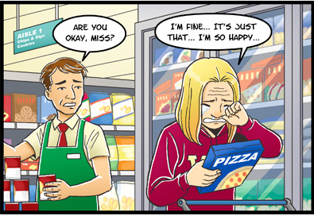
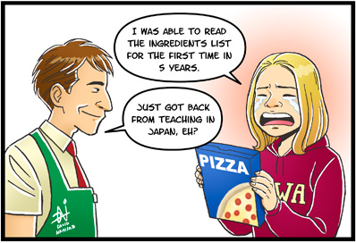
After JET ... REPATRIATION
Life After the BOE: David Namisato

Slide 39
Reverse Culture Shock Stories
Be aware of it
  You’ve changed, so has your home
  Idealized version of home
  You can’t always pick up where you left off
  People want Japan in a nutshell.
  JETAA + other groups
  A little downtime is OK.
  SEE: Google / Youtube
Notes:
2010 JETAA Survey 65.7%
Disengagement, initial euphoria, Irritability and hostility, Readjustment and adaptation.

Slide 40
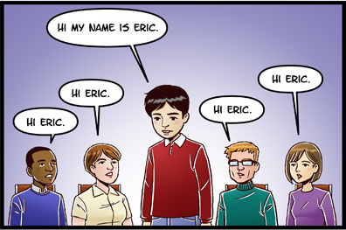
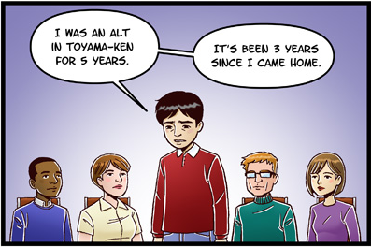
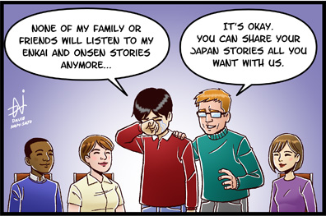
JETAA: We’re Here For You
Life After the BOE: David Namisato

Slide 41
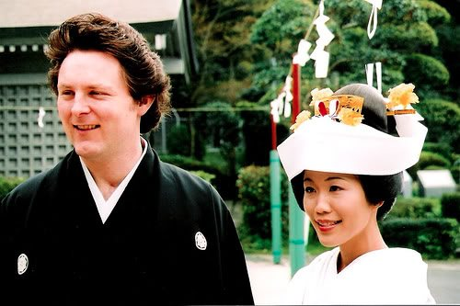
Malingering
3rd year + JETs be aware of your visa status.
  Don’t let it expire!
30 days to get gone if you want your ticket home paid (otherwise 90).
Visitor Visa
  Immigration Office
    Bring inkan, Gaijin card, ¥4000, passport, and documentation showing the termination of your contract

