Slide 1
Interview Evaluations

Slide 2
Interview Evaluations
Voice &
Pronunciation
Memorization
Question & Answer
Content
The interview presentations are evaluated on four aspects. Each aspect has a possible 5 points which are then added together for a possible total 20 points.

Slide 3
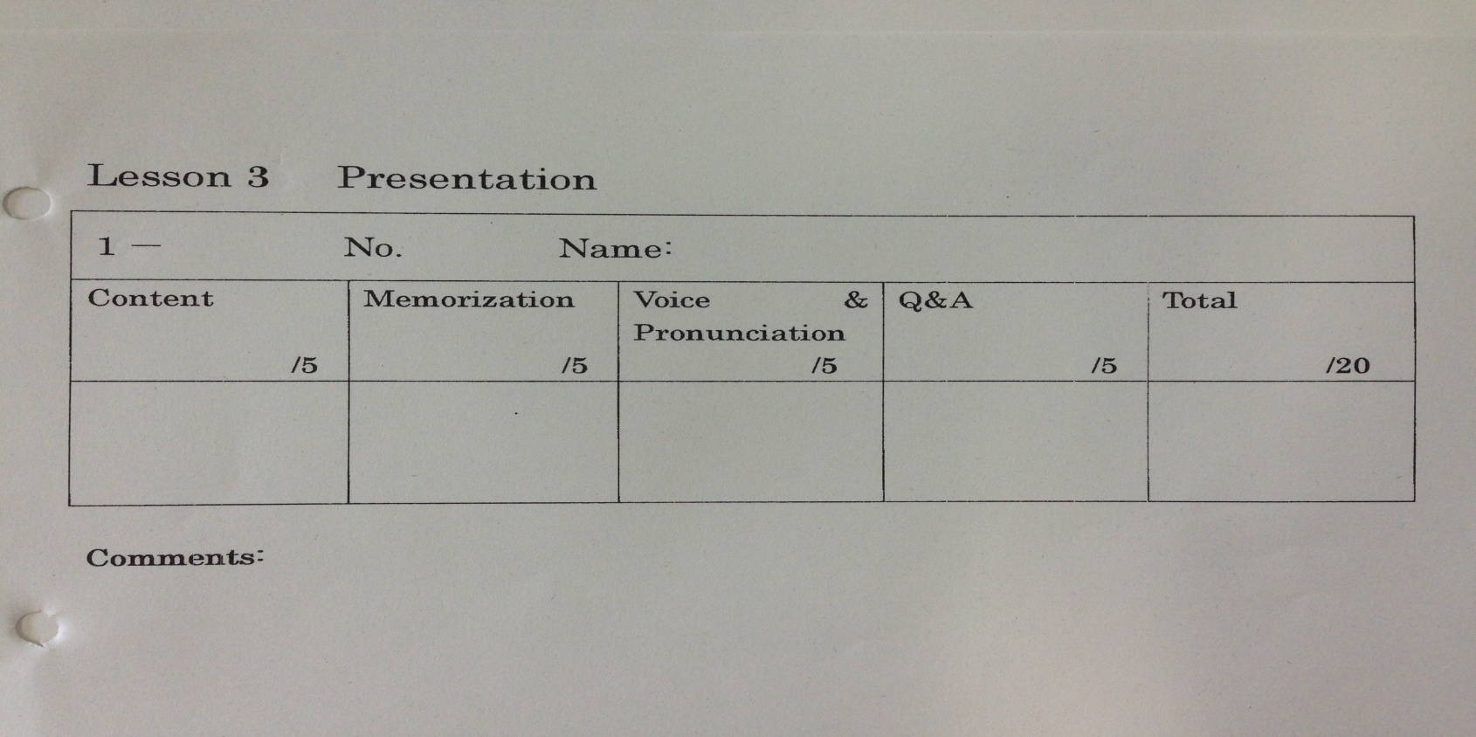
Evaluation Sheet

Slide 4
Content
1 point:
The presentation is messy, not understandable, or way too short.
2 points:
The presentation is messy, difficult to understand, or too short.
3 points:
The presentation was short and/or consisted of mostly example sentences with no creativity or thought.
4 points:
The students met the length requirements and created a neat, understandable presentation.
5 points:
The student surpassed the length requirement and/or showed extra creativity.

Slide 5
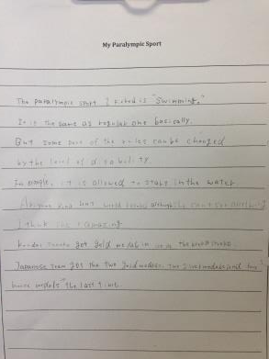
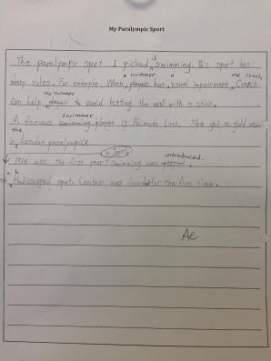
Examples of Ideal Content

Slide 6
Memorization
1 point:
The student reads their presentation in a flat voice or cannot remember their presentation at all and gives up.
2 points:
The student refers to their script a few times but has memorized most of it.
3 points:
The student has it completely memorized and does not look at their script, though the presentation has long pauses.
4 points:
The presentation is completely memorized with only a couple short pauses.
5 points:
The presentation is completely memorized, no pauses, and the student makes eye contact.

Slide 7
Voice & Pronunciation
1 point:
The presentation is not understandable due to pronunciation errors, mumbling, or nearly silent voice.
2 points:
The presentation is barely understandable due to pronunciation errors, mumbling, or quiet voice.
3 points:
The presentation is difficult to understand due to many pronunciation errors, mumbling, or quiet voice.
4 points:
There are a few pronunciation errors but the student speaks clearly and loud.
5 points:
The student speaks with few or no pronunciation errors in a clear, loud voice with correct intonation.

Slide 8
Question & Answer
1 point:
The student cannot answer either question and does not try to.
2 points:
The student takes a very long time to answer and cannot answer correctly even when the questions are repeated.
3 points:
The student answers one question correctly but cannot answer the second.
4 points:
The student answers both questions correctly but does not use complete sentences.
5 points:
The student answers both questions correctly, quickly, and in complete sentences.

Slide 9
Examples of Ideal Presentations
Four Video Examples

