Slide 1
TESOL while on JET
Justin Foster-Sutherland

Slide 2
Agenda
Introduction
My story
What are you looking for in a TESOL course?
Some basic TESOL pointers
Where to go next

Slide 3
When you leave JET what will you take back with you?

Slide 4
Wanna stay in Japan?

Slide 5
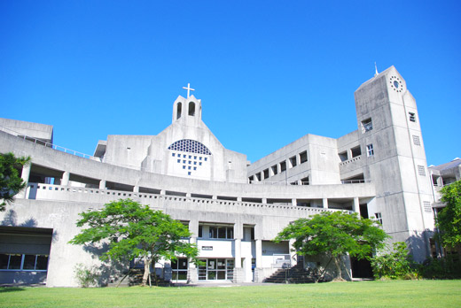
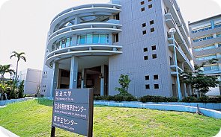
My story Option 1

Slide 6

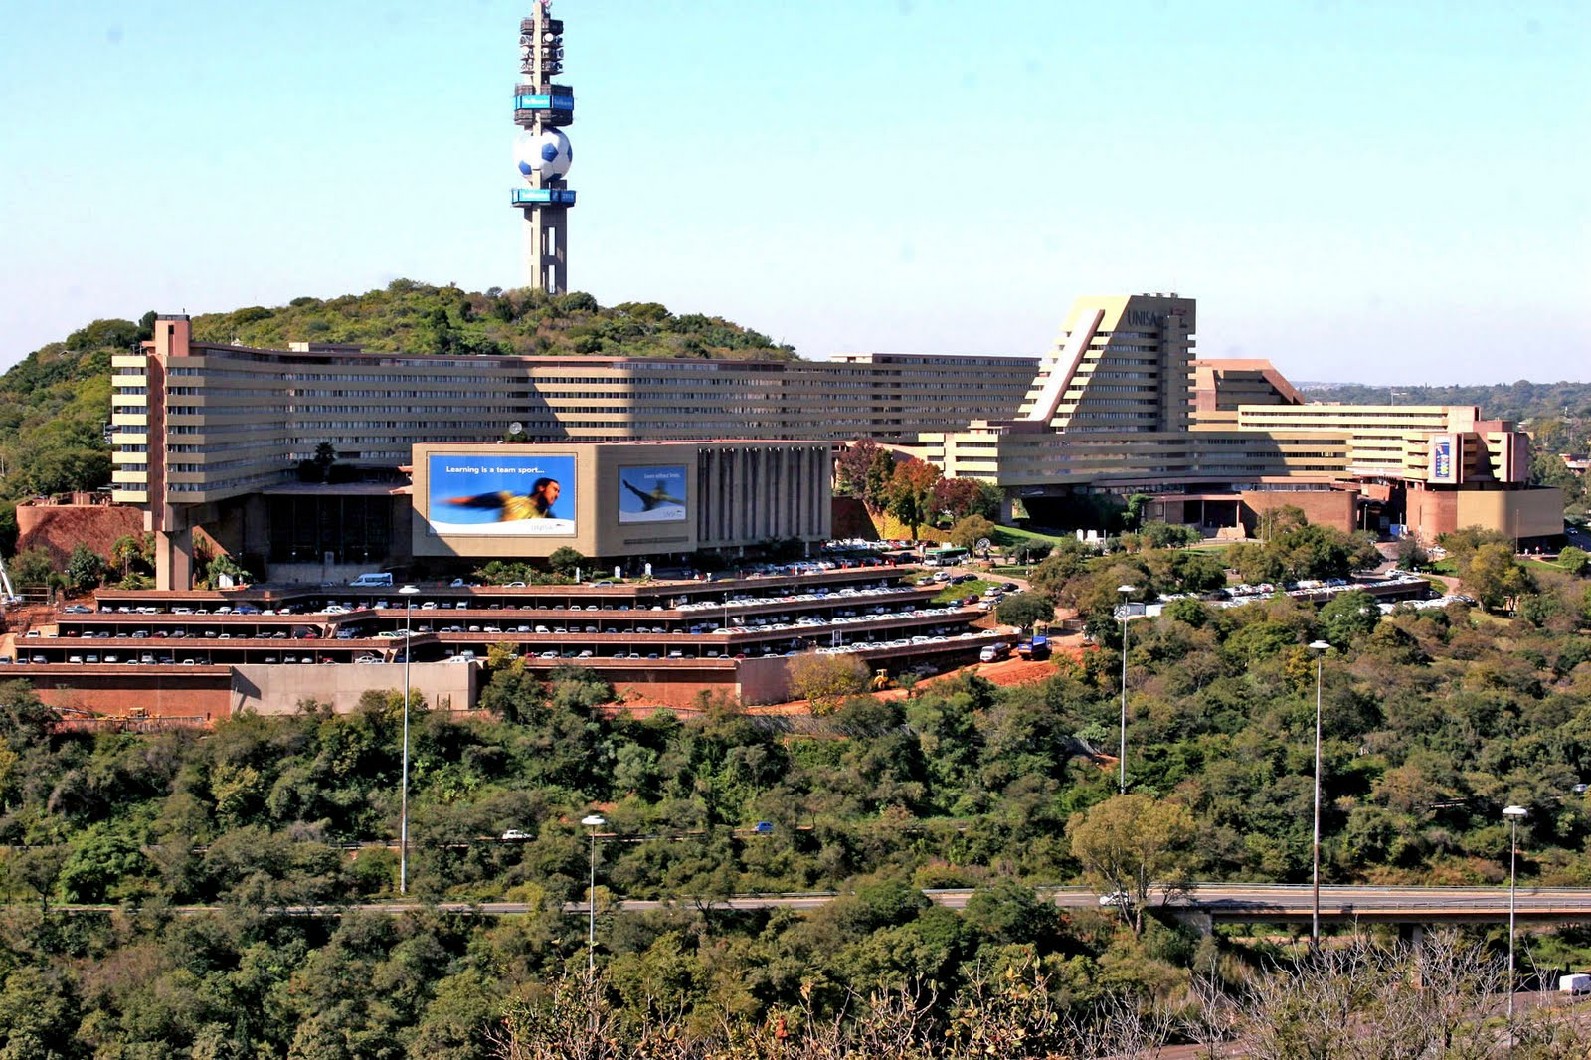
My story Option 2

Slide 7


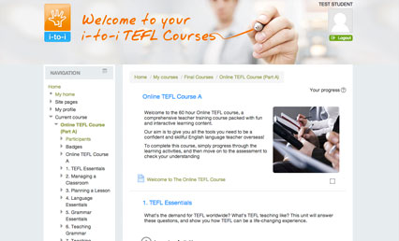
My story Option 3

Slide 8
Which is the best?

Slide 9
So, what do you expect to learn?

Slide 10
Was it worth it?

Slide 11
Some tips

Slide 12
Don't re-invent the wheel.

Slide 13
Lesson is a sequence of activities that link with each other.

Slide 14
Have you done the activity yourself first?

Slide 15
Learn about your students.

Slide 16
Student focused activities

Slide 17



What to do next.

Slide 18


