Slide 1
THE ART OF
TEACHING
WORKSHOP
SDC 2014

Slide 2

Today’s Workshop
Teaching in Ireland: Comparison & Methods
Teaching in Japan: Challenges & Solutions
DEMO: Effective Games & Activities
Discussion Forum (Q&A)
Workshop Challenge:
Let’s do it all in English!

Slide 3
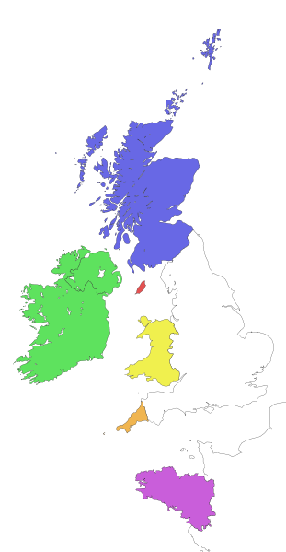
The Irish Language
(Gaelic)
a Celtic language (English is West Germanic)
2,500+ yrs old (oldest still spoken in Europe)
Prohibited by English rulers until 1871. Official EU language since 2007.
LAW: Mandatory in public schools (age 5-16)
University requirement: must pass Irish, English & Math (+ 3 other subjects, to include a foreign language).
While 41% of the Irish population say they can speak it, only 18.7% speak it daily.

Slide 4


An Irish Perspective
Teachers are rarely native speakers of Irish.
Few teachers feel grammar confident.
Students have low motivation to speak it (cultural> “not good enough” ) .
Similar to Japan: ashamed that after 12+ years of study, still can’t speak Irish well.
Why?

Slide 5

Let’s Discuss
The basics of teaching any language
how to remedy cultural handicaps while teaching
how to enable language acquisition independent of reading
how to maximize student speaking time in class
how to best use team-teaching to achieve the above.

Slide 6

Pick Me!
WARM-UP GAME

Slide 7

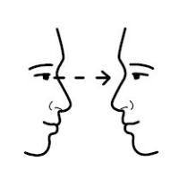
Warm up 1: Pick Me!
Q&A pair practice with emphasis on REAL COMMUNICATION/ impromptu speaking.
“Too slow!” (think fast)
“Eye contact!” (focus on the listener)
“No reading!” (think for yourself)
Notes:
Even fluent Ss (with an American parent) refer to the text. It's a Japanese HABIT.

Slide 8
Please introduce yourself
Hello, my name is _______
I come from _______
I teach at _______
Teacher models
> Level up!
>> Teacher facilitates

Slide 9
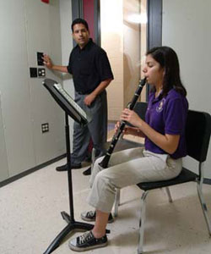
Let’s Discuss
I can’t learn to play the clarinet by watching someone else play.
How do we create opportunities for each student to practice using as much English as possible during class?
NO CHILD LEFT BEHIND

Slide 10
Please share an idea
One thing we do in my school is ...
PICK-ME RULES
Eye contact
Fast reply
NEW answer

Slide 11

Handouts
WARM-UP GAME

Slide 12
The Handout Race
A: How many sheets?
B: Six sheets please!
A: Here you are.
B: Thank you very much!

Slide 13

Planning
Planning
Planning

Slide 14
PLANNING Term Schemes
JTE informs ALT of English Dept scheme for the term (per grade)
JTE & ALT discuss potential TT INTEGRATION opportunities.
ALT proposes TT Term Scheme
Eng. Dept. Scheme Approval
Then... ALT creates Real-Life use
Lesson/Activity Planning (ALT)
Scheme Review (JTE & ALT)

Slide 15
Signs Drill
MAIN ACTIVITY

Slide 16

Lesson Plannning (Irish Style)
Where's the Goalpost? (Objectives) e.g. By the end of the Lesson the Students will be able to...
Evaluate based on that (did 60%+ of Ss reach that goal? Why not?)
Note challenges that present themselves (e.g. Ss are not used to X)
Integrate the problems identified into Term Scheme (e.g. Special lesson on X)
  e.g. pronunciation difficulties with "W"
  e.g. students are used to answering questions but struggle to ask/compose questions; etc.

Slide 17
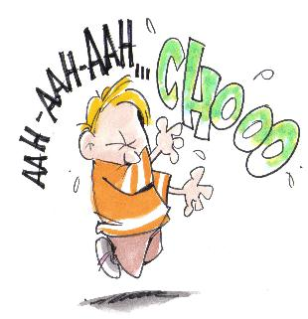

Teaching Techniques (Irish Style)
More time spent on drill-learning
More focus on memory work less paper supports
Avoiding "TING-A-LING" Syndrome
Dia linn!
"Bless you" in Gaelic
Ting-a-ling!

Slide 18

Concentration
WARM-UP GAME

Slide 19


The Backwards Buildup
Teach and drill pronunciation from the last syllable backwards
Concentration
Con – cen – tra – tion
~tion … ~tration … ~centration
Concentration! (Native speed)
  Samhain
  Baile Átha Cliath

Slide 20

The Sandwich Method
When gestures and pictures fail...
Sandwich the translation between the new word/phrase.
Concentration...
... Shuchu (集中)
... Concentration!

Slide 21

Avoiding 'Ting-a-ling'
Listen to Teacher x 3 (before Ss repeat)
  "Listen!... Concentration ... Concentration ... Concentration"
Teacher> Sole Student >Teacher repetition
  "Concentration."
  Concentration!
  "Concentration"
Group Repetition x 3
"Together!" "Concentration!"
"Again!" ... "Again!" ...

Slide 22
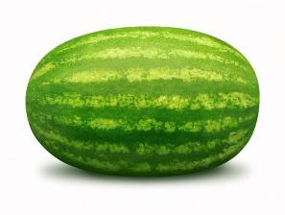
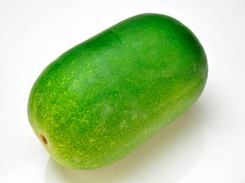

The A, B, Cs of Review
A Name it “What’s this ~ ?”
B Explain it “Show me ~”
C Differentiation “Is this ~ ?”
ア マ ｂｄｐｑ
ツ シ Ｒ Ｌ

Slide 23




Quiz/Review Games
Teach how to play in chunks (play by steps)
Introduce Play “idioms” & practice
Set a time limit to speak up
Whole team must answer (peer pressure)
A – B – C Questions
Double points for incentives
JTE devises prize (pass for free seating/homework etc).
(Comprehension discussion in pairs)

Slide 24

Picture Talkabout
HEXAGON LEARN & DRILL GAME

Slide 25
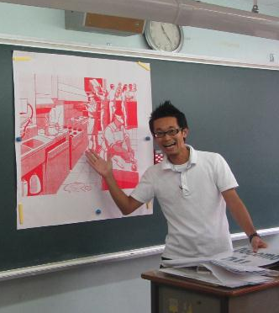
Speech Development
Describe the Situation (Picture Hexagon )
LAYER 1
What can you see in the picture?
LAYER 2
What were they doing just before?
What will they do next?
LAYER 3
What are they saying?
What are they thinking?

Slide 26

Expanding Layers
What can you see?
What were they doing before?
What will they do
next?
What
is this man thinking?

Slide 27
Discussion Forum
QUESTIONS & ANSWERS

